Slide 1


Your Water, Your Say
Eich Dŵr, Eich Llais

Slide 2
Housekeeping
This session will be RECORDED for note-taking purposes only
Please make sure your microphone remains on MUTE unless you have been asked to speak
or pose a question
Please keep your camera ON if you feel comfortable and have a good connection
If you want to ask a question live, please use the RAISE HAND gesture during the Q&A section
Questions can be typed into the CHAT facility at any time
Automated captions can be turned on via the ‘SHOW CAPTIONS’ button
To choose LANGUAGE audio settings go to menu at the top of the screen, select the “. . . / More” button, and click on “Language and Speech” where you will be able to select interpretation. The two channels available are – “Original Language” in which you will hear both spoken Welsh and English, or “English” which will be English language only with simultaneous translation of any spoken Welsh
If you are having any TECHNICAL issues, please alert us in the chat (or via yoursay@dwrcymru.com)
WRITTEN questions can still be submitted up to 24 hours after this session concludes and will still form part of the official record of the session
The PRESENTATION will be available on dwrcymru.com soon after the meeting
A WRITTEN RECORD of the meeting will be available within 21 days.
Notes:
This is the basis for your housekeeping slide – you can use a slide that fits your style and language; add necessary details (including making it applicable to Zoom or Teams) as well as icons/images etc. as you deem fit.

Slide 3

Cynllun Busnes
Dŵr Cymru
Welsh Water
Business Plan
2025-30
Peter Perry
Chief Executive

Slide 4
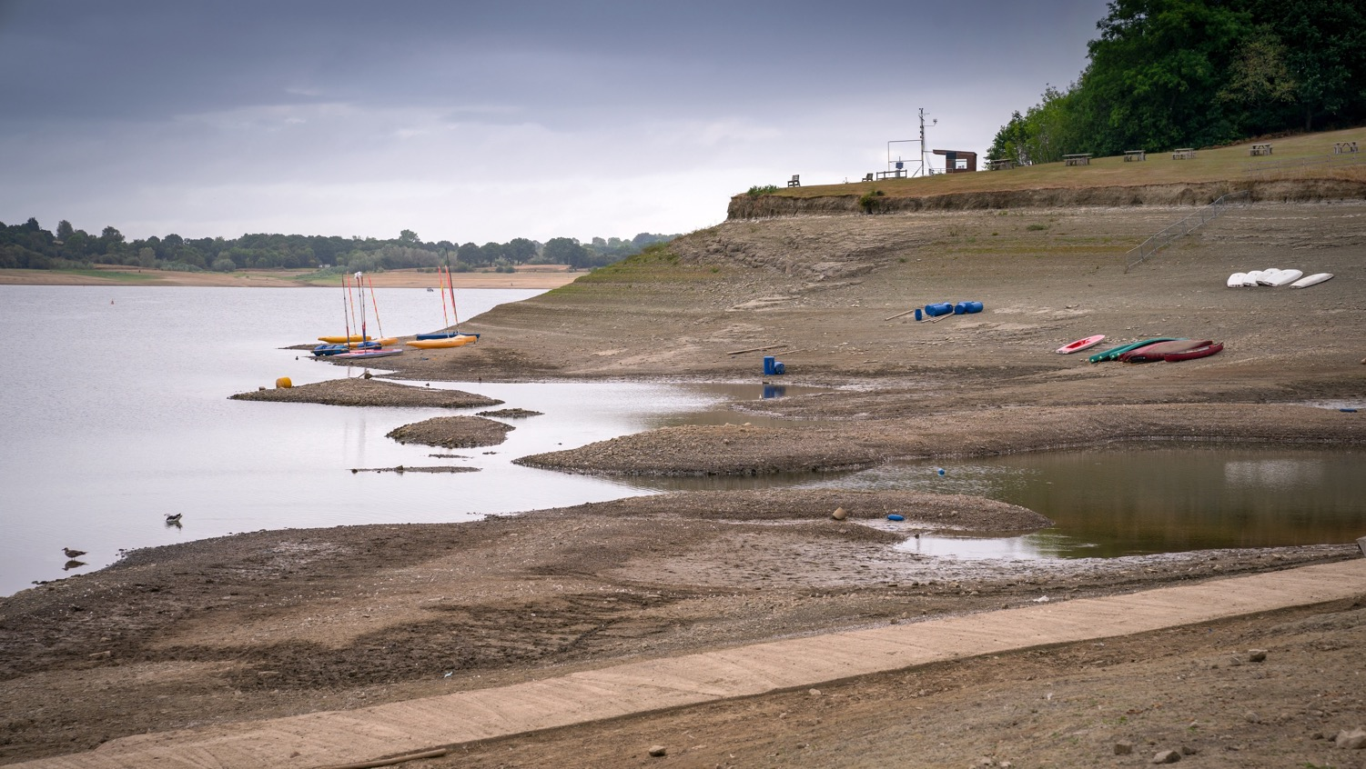
OUTLINE OF PRESENTATION
    Introduction to the Executive Team on the panel
    Highlights of our Business Plan for 2025-30
      Water business (Ian Christie)
      Wastewater business (Steve Wilson)
      Retail/customer services (Samantha James)
    Key issues raised in our first ‘Your Water, Your Say’ meeting and our response
    Questions and answers to follow

Slide 5

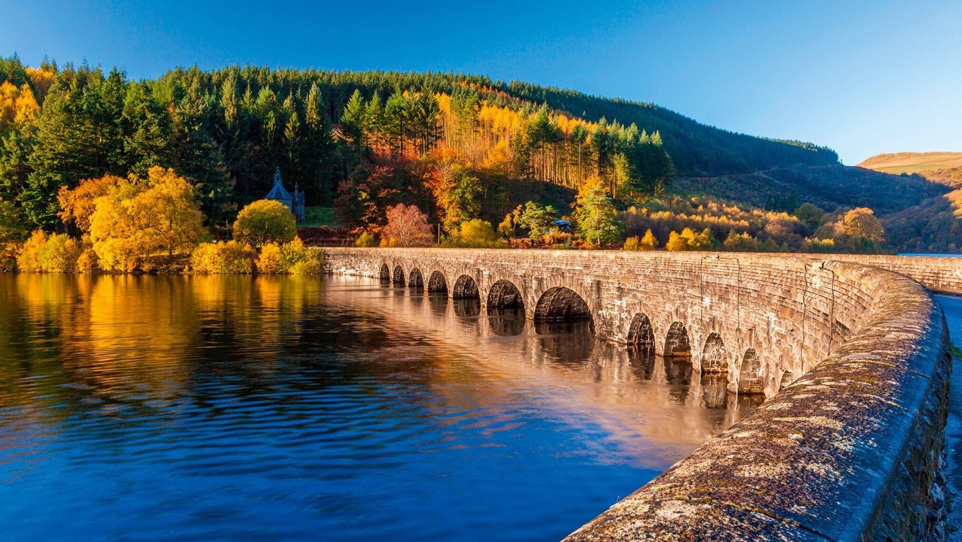
BUSINESS PLAN 2025-30 [PETE]
Our Business Plan is…
Part of long-term plan to 2050
Based on consultation with customers and regulators
Subject to scrutiny and challenge by Ofwat
Final decisions announced December 2025

Slide 6
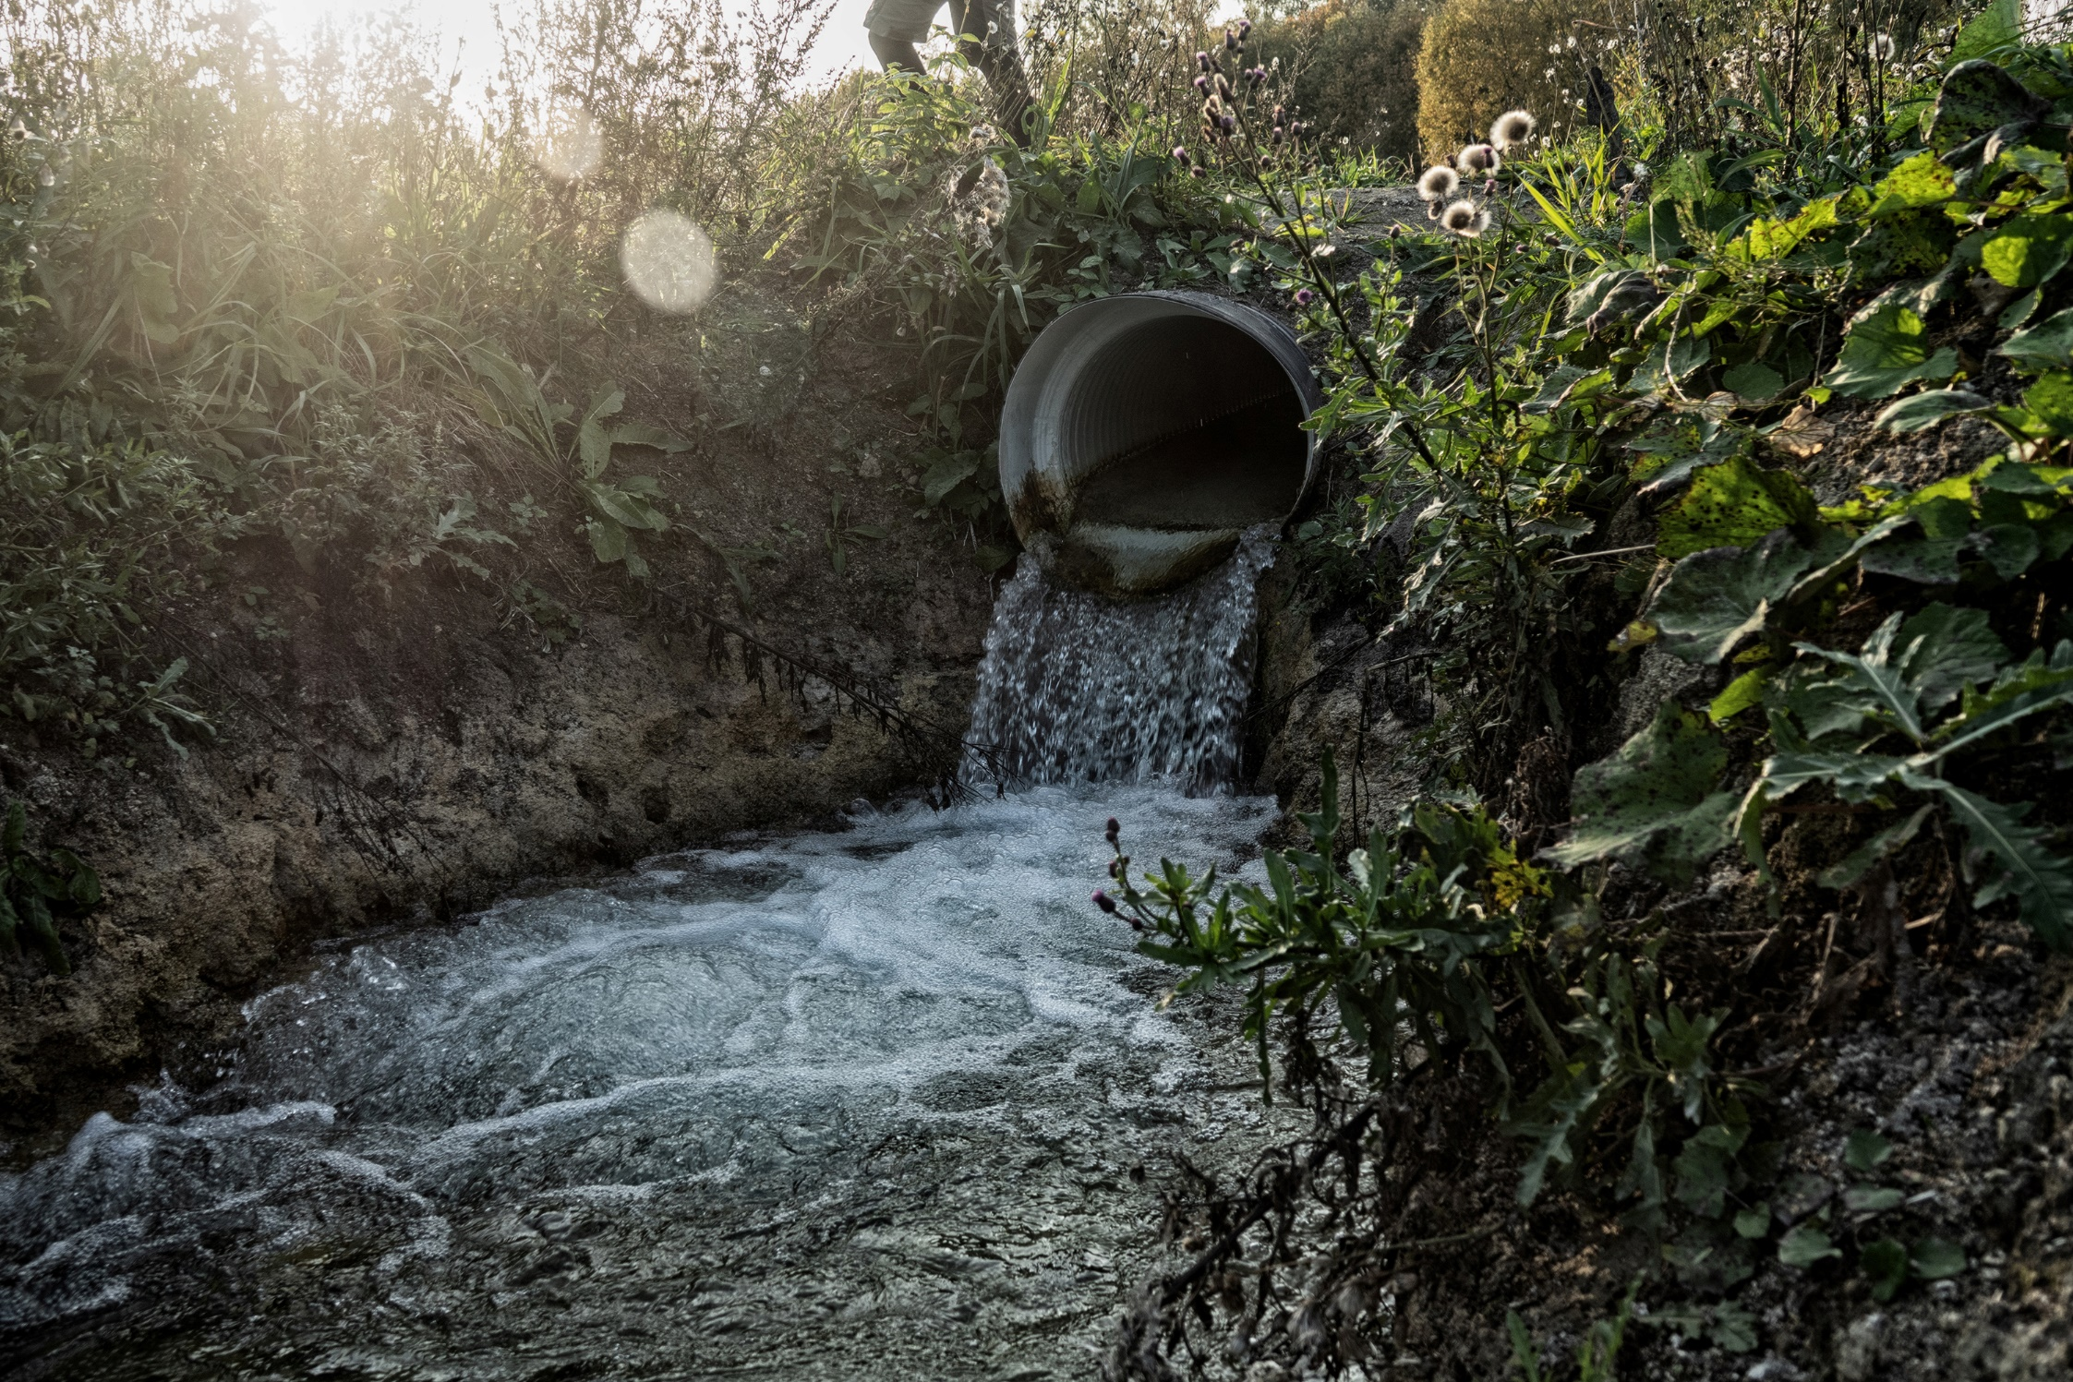
BUSINESS PLAN 2025-30 [PETE]
CHALLENGES
Current performance challenges on some regulatory measures
Public concern around storm overflows and pollution
Need for greater resilience to climate change and extreme weather
Progress towards net zero carbon emissions
Huge asset base in need of modernisation

Slide 7

BUSINESS PLAN 2025-30 [PETE]
Major step up in investment to meet long-term challenges
and improve the environment
  £3.5 billion capital investment programme(68% bigger than forecast AMP7 total)
  £1.9 billion of wastewater investment to protect the environment
  Targeting return to 4-star Environmental Performance Assessment
2. Increase in bills and more support to those who struggle to pay
  Average bills up by 26% but lower than sector average
  Social tariffs extended for eligible customers on low incomes.
Avoid storing up problems for future generations
Notes:
Context
Safe high-quality drinking water is an essential public service and is our number one priority.
We believe that our customers should be able to depend on their water supply, now and in the future.
Our current performance on tap water quality is good on safety, but we have some challenges on tap water quality (e.g. discolouration incidents and CRI).
Issues
Climate change means we are expecting more frequent droughts, which we have to plan for
It is also affecting the quality of raw water arriving in our reservoirs, and this can feed through into tap water quality unless we take action.
Some of our pipe materials are no longer fit for purpose and need replacement over time.
Actions we will take
We are learning the lessons from last year’s drought and build more resilience into our water networks, for example by connecting water supply zones.
On water quality we will continue to work with landowners and farmers in water catchments. And we will upgrade our treatment works and networks to reduce incidents of water discolouration.
Outcomes to be achieved
Currently we receive about xx contacts from customers about tap water quality each year. We will reduce this to around xxx by 2030.
We will cut supply interruptions from an average of xx in the last 3 years to xxx by 2025 and maintain this level to 2030.
We will ensure we have sufficient supply to meet demand accounting for climate change and droughts, out to 2050.

Slide 8

KEY FACTORS FOR OUR DRAFT BUSINESS PLAN
DELIVERABLE
AFFORDABLE
FINANCEABLE
Notes:
Context
Safe high-quality drinking water is an essential public service and is our number one priority.
We believe that our customers should be able to depend on their water supply, now and in the future.
Our current performance on tap water quality is good on safety, but we have some challenges on tap water quality (e.g. discolouration incidents and CRI).
Issues
Climate change means we are expecting more frequent droughts, which we have to plan for
It is also affecting the quality of raw water arriving in our reservoirs, and this can feed through into tap water quality unless we take action.
Some of our pipe materials are no longer fit for purpose and need replacement over time.
Actions we will take
We are learning the lessons from last year’s drought and build more resilience into our water networks, for example by connecting water supply zones.
On water quality we will continue to work with landowners and farmers in water catchments. And we will upgrade our treatment works and networks to reduce incidents of water discolouration.
Outcomes to be achieved
Currently we receive about xx contacts from customers about tap water quality each year. We will reduce this to around xxx by 2030.
We will cut supply interruptions from an average of xx in the last 3 years to xxx by 2025 and maintain this level to 2030.
We will ensure we have sufficient supply to meet demand accounting for climate change and droughts, out to 2050.

Slide 9
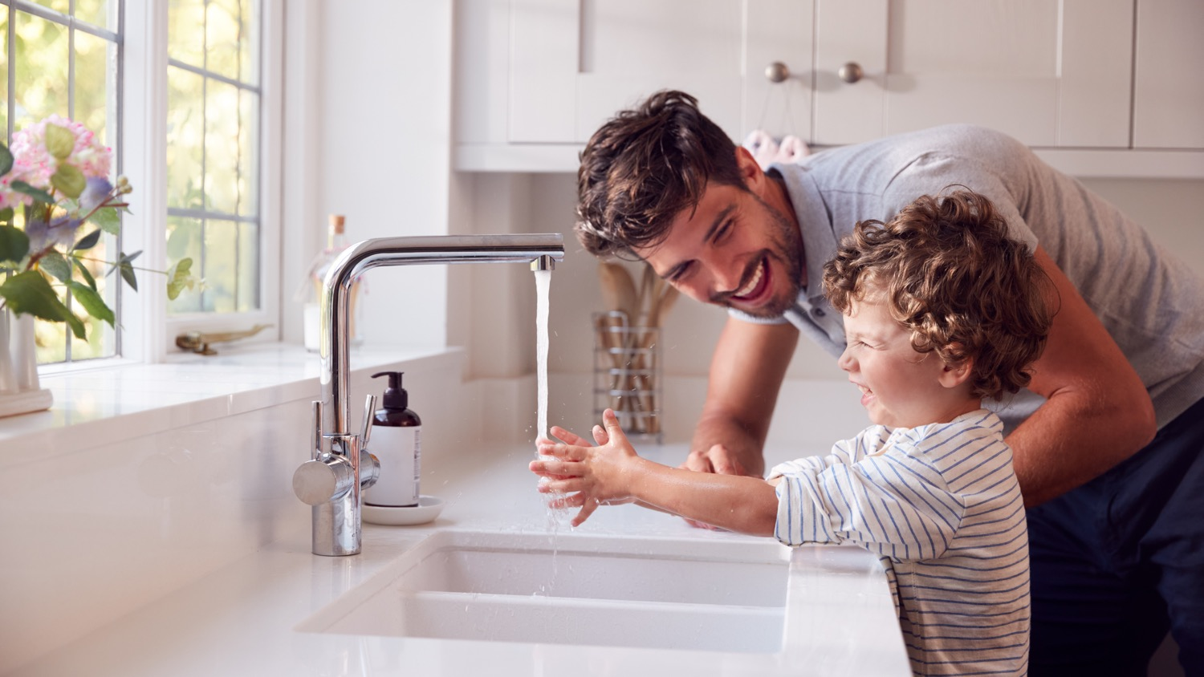
WATER BUSINESS (Ian Christie)
STAKEHOLDER PRIORITIES
Customer priorities
Water supply resilience
Reducing leakage
Regulators priorities
Tap water discolouration
Learning lessons from 2022 drought
Dam resilience
BUSINESS PLAN ‘HEADLINES’
Performance improvements to 2030
10% reduction in leakage – 3 year average
(191 ML/day in 2025 to 173 ML/day).
44% reduction in supply interruptions (from 8 minutes per customer in 2025 to 4.5).
£360 million to improve tap water quality
Partnerships in catchments uplands
Treatment works maintenance & upgrades
Replacing customers’ lead pipes
£220 million water resilience investment
£160m towards long-term programme
of dam upgrades
Replacing ageing pipe materials
£60m to connect supply zones

Slide 10
WASTEWATER BUSINESS (Steve Wilson)
BUSINESS PLAN ‘HEADLINES’
Performance improvements to 2030
19% reduction in pollution incidents (from 78 in 2025 to 68)
17% reduction in internal sewer flooding (from 168 in 2025 to 139)
21% reduction in external sewer flooding (from 3400 in 2025 to 2700)
Maintaining excellent bathing water quality
Return to ‘4-star’ environmental performance
STAKEHOLDER PRIORITIES
Customer priorities
River and bathing water quality
Storm overflows
Reducing sewer flooding
Regulators priorities (in addition)
Reducing phosphorous levels in rivers
Pollution incidents
BUSINESS PLAN ‘HEADLINES’
Of £1.9bn total wastewater expenditure, £1.2bn of ‘enhancement’ to meet new regulatory standards set by NRW & EA
£366 million for tackling priority storm overflows having biggest environmental impact
£141 million for reducing phosphorous discharged to Special Areas of Conservation rivers – 100% reduction to sustainable levels by 2032 (90% by 2030)
£78m to tackle resilience of wastewater infrastructure in sensitive areas
£110m to improve flows treated at wastewater treatment works

Slide 11

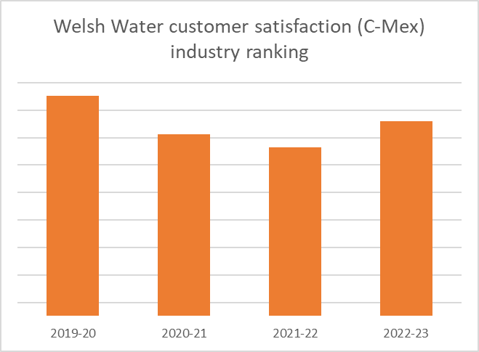
CUSTOMER SERVICE (Samantha James)
“Earning the trust of customers every day”
Continued support for vulnerable customers
Supporting behaviour change for lower consumption and bills
£110m for progressive customer metering strategy
Education programme
Retain our Wales-based contact centre so that our customers can always call and speak to a real person in English or Welsh who can help them
1st
3rd
4th
5th
Currently 3rd of 17 on Ofwat’s ‘Customer Measure of Experience’.

Slide 12
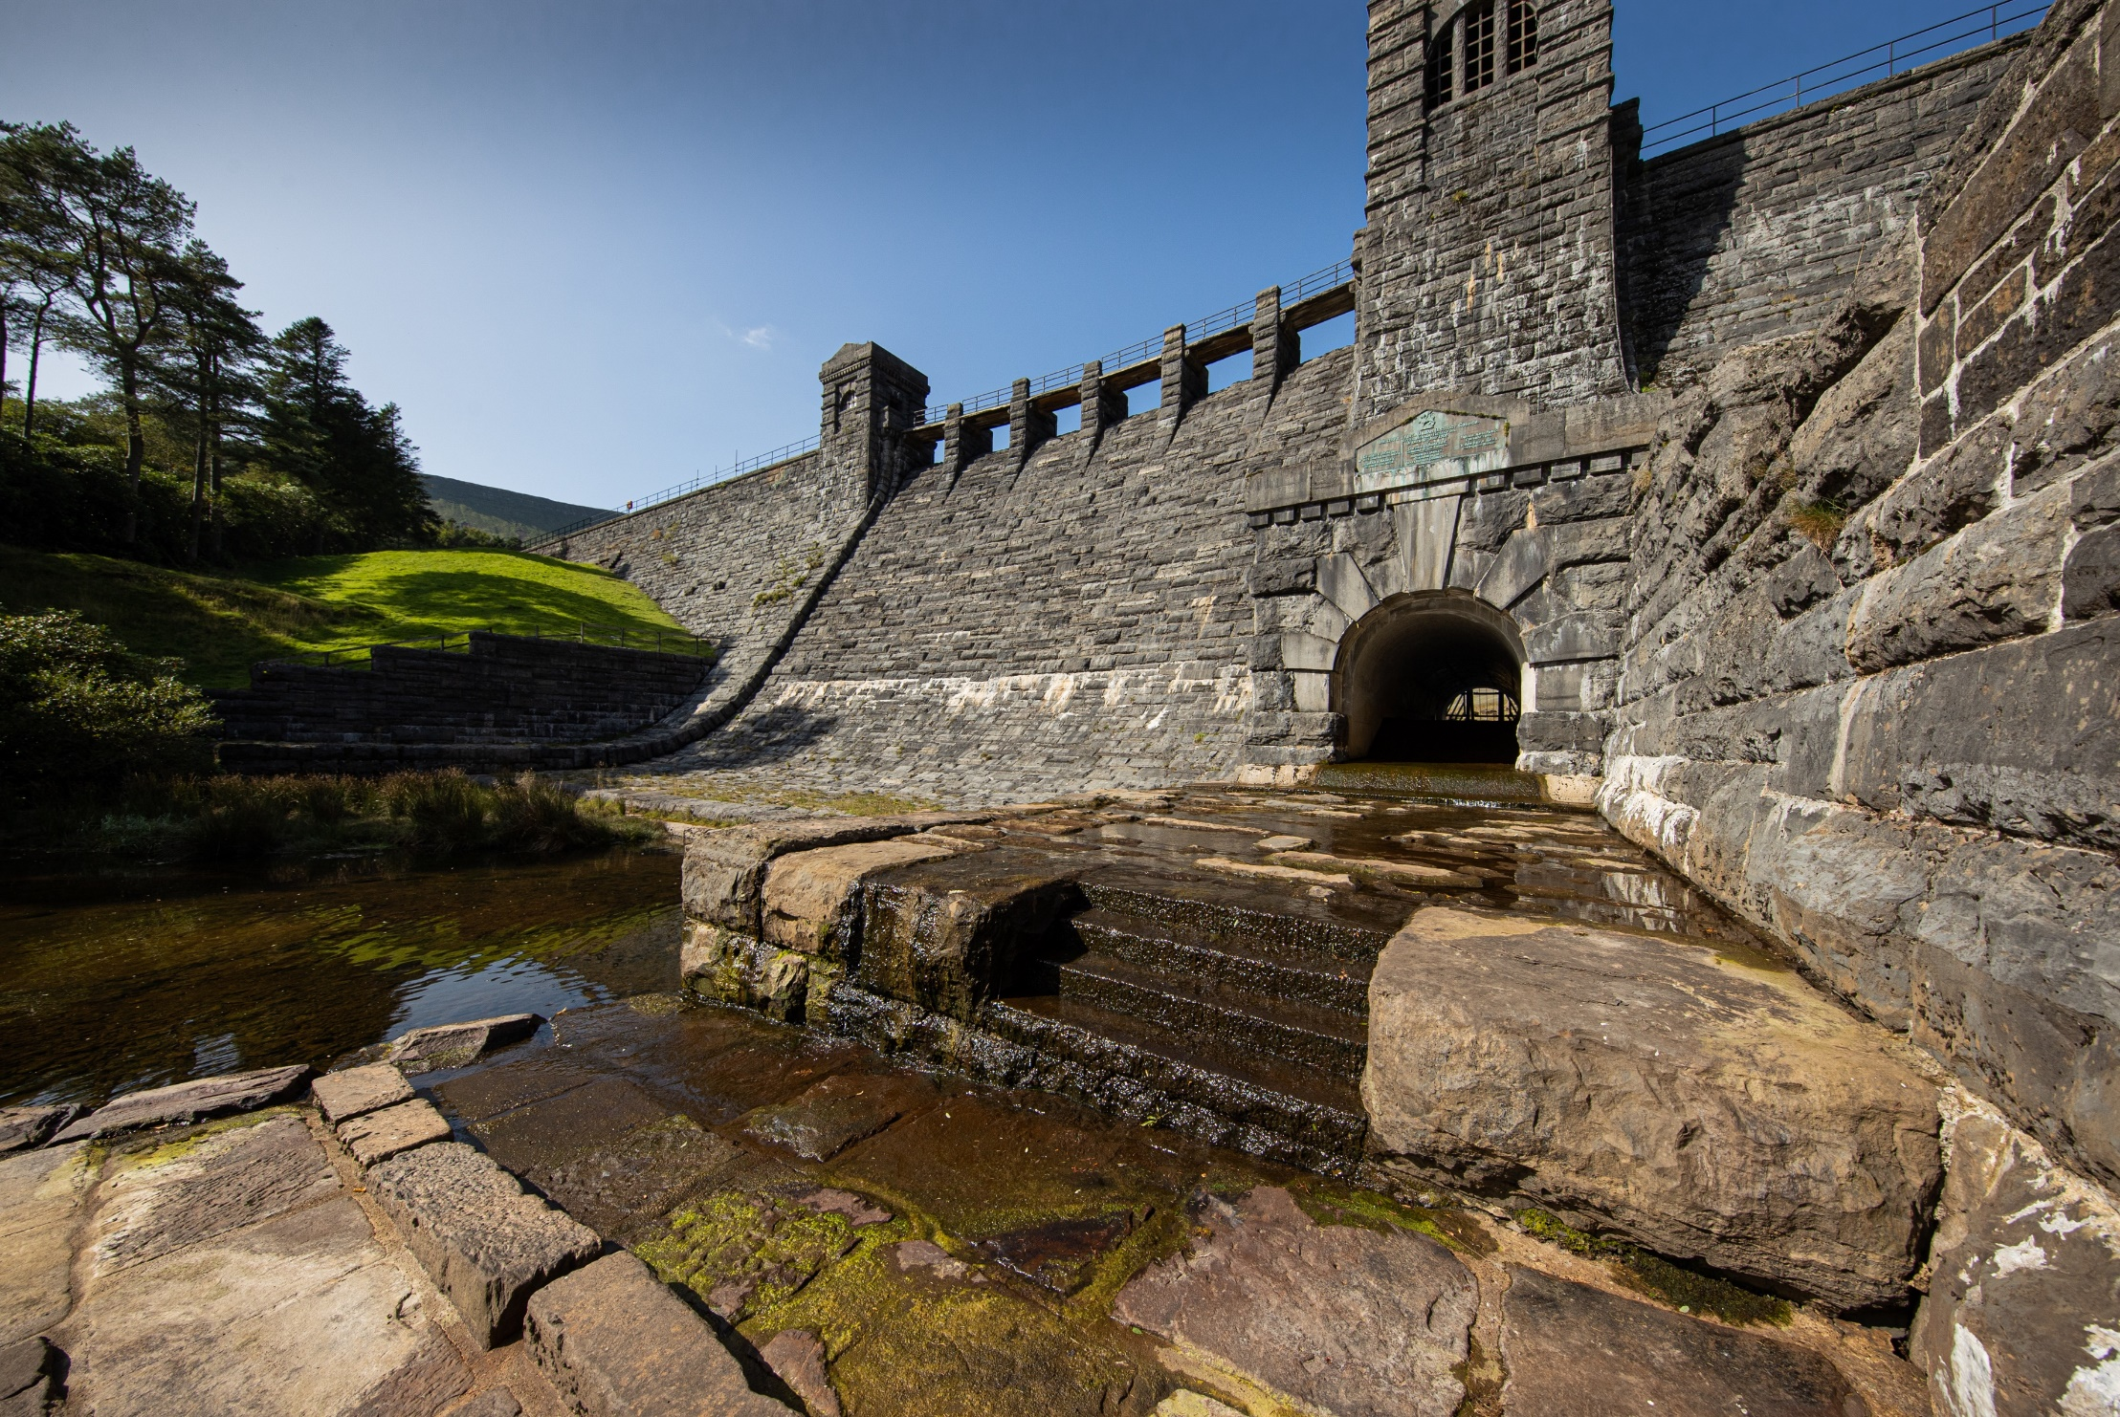
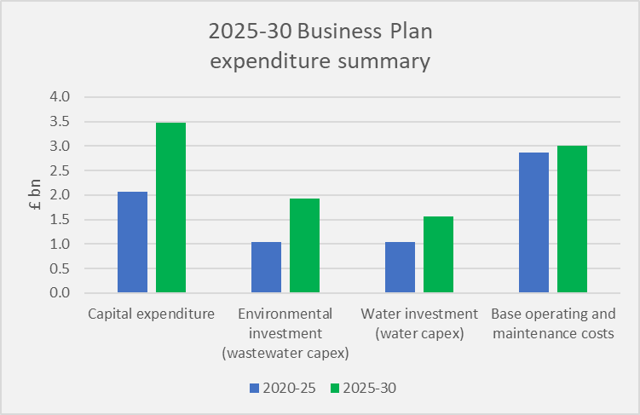
EXPENDITURE (Peter Perry)
Biggest ever investment plan.
Major step up from historical levels.
Required to improve environment, secure long-term resilience.
Efficiency and innovation essential.

Slide 13

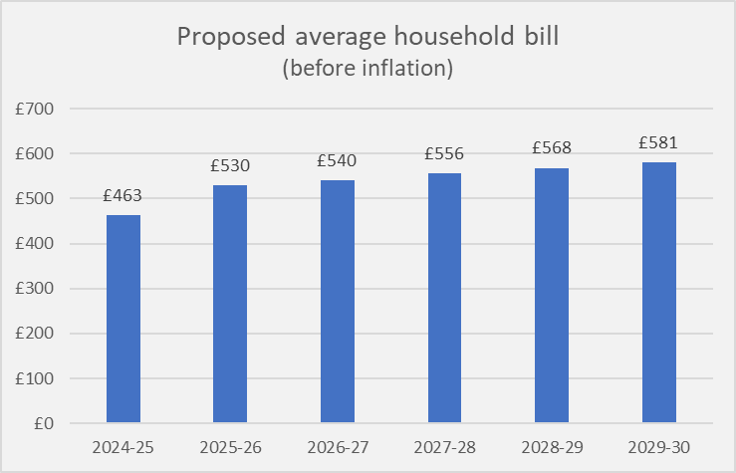
BILLS AND AFFORDABILITY (Peter Perry)
Average bill increase: £5 per month in 2025 rising to £11 per month by 2030.*
Overall increase of 26% by 2030
before inflation.
This is below the average proposed increase in the industry of 30% and
by 2030 would mean Welsh Water customers have 7th highest bills of all companies in England and Wales (currently we have the second
highest level of bills).
Highest financial support in the industry to support lowest income households
* before inflation – compared to today’s average household bill.

Slide 14

Plan Acceptability & Affordability (Peter Perry)
84% of household participants find the plan acceptable
15% of household customers said that the bills would be 'easy' or 'very easy' to afford
80% support amongst customers who are struggling financially

Slide 15
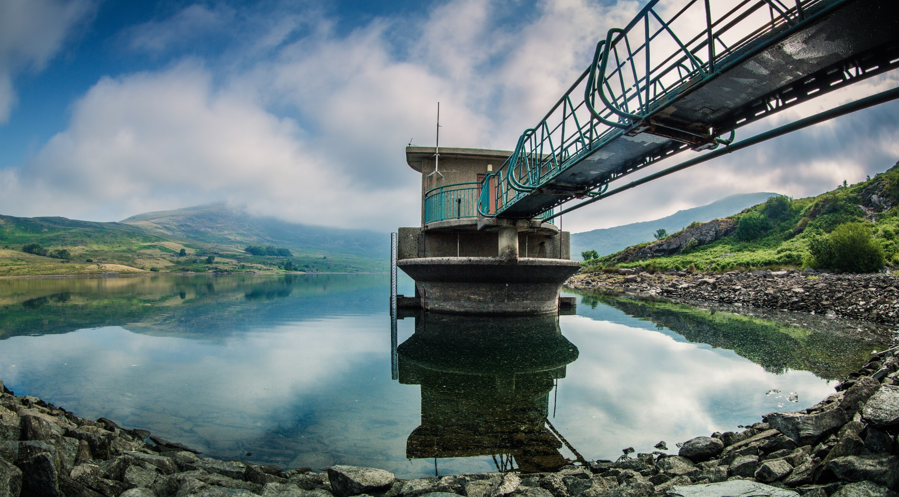
Summary
Avoid storing up problems for future generations
Major step up in investment to meet long-term challenges and improve the environment
Increase in bills in time of financial difficulty for many, with social tariffs to support those who struggle to pay

Slide 16

Responses to ‘Your Water, Your Say’ (Pete)
ISSUE RAISED (‘YOU SAID’) | RESPONSE (‘WE DID’)
Concerns over river pollution | Biggest ever environmental investment programme (over £1 billion)
Level of bills, and support available to those struggling to pay. | Bills increasing, but by less than the average. Maintaining and enhancing support for those struggling to pay.
Levels of leakage and ensuring resilience against events such as drought | Huge focus on leakage – 18% reduction by 2030. Well positioned on drought resilience. Also helping customers to reduce usage.
Availability of Welsh language services. | Commitment to retain Wales-based contact centre, so customers can quickly speak to someone who can help them (English or Welsh).

Slide 17

YOUR QUESTIONS
Environment and wastewater
Water supplies and tap water quality
Customer services priorities
Affordability
Other

Slide 18
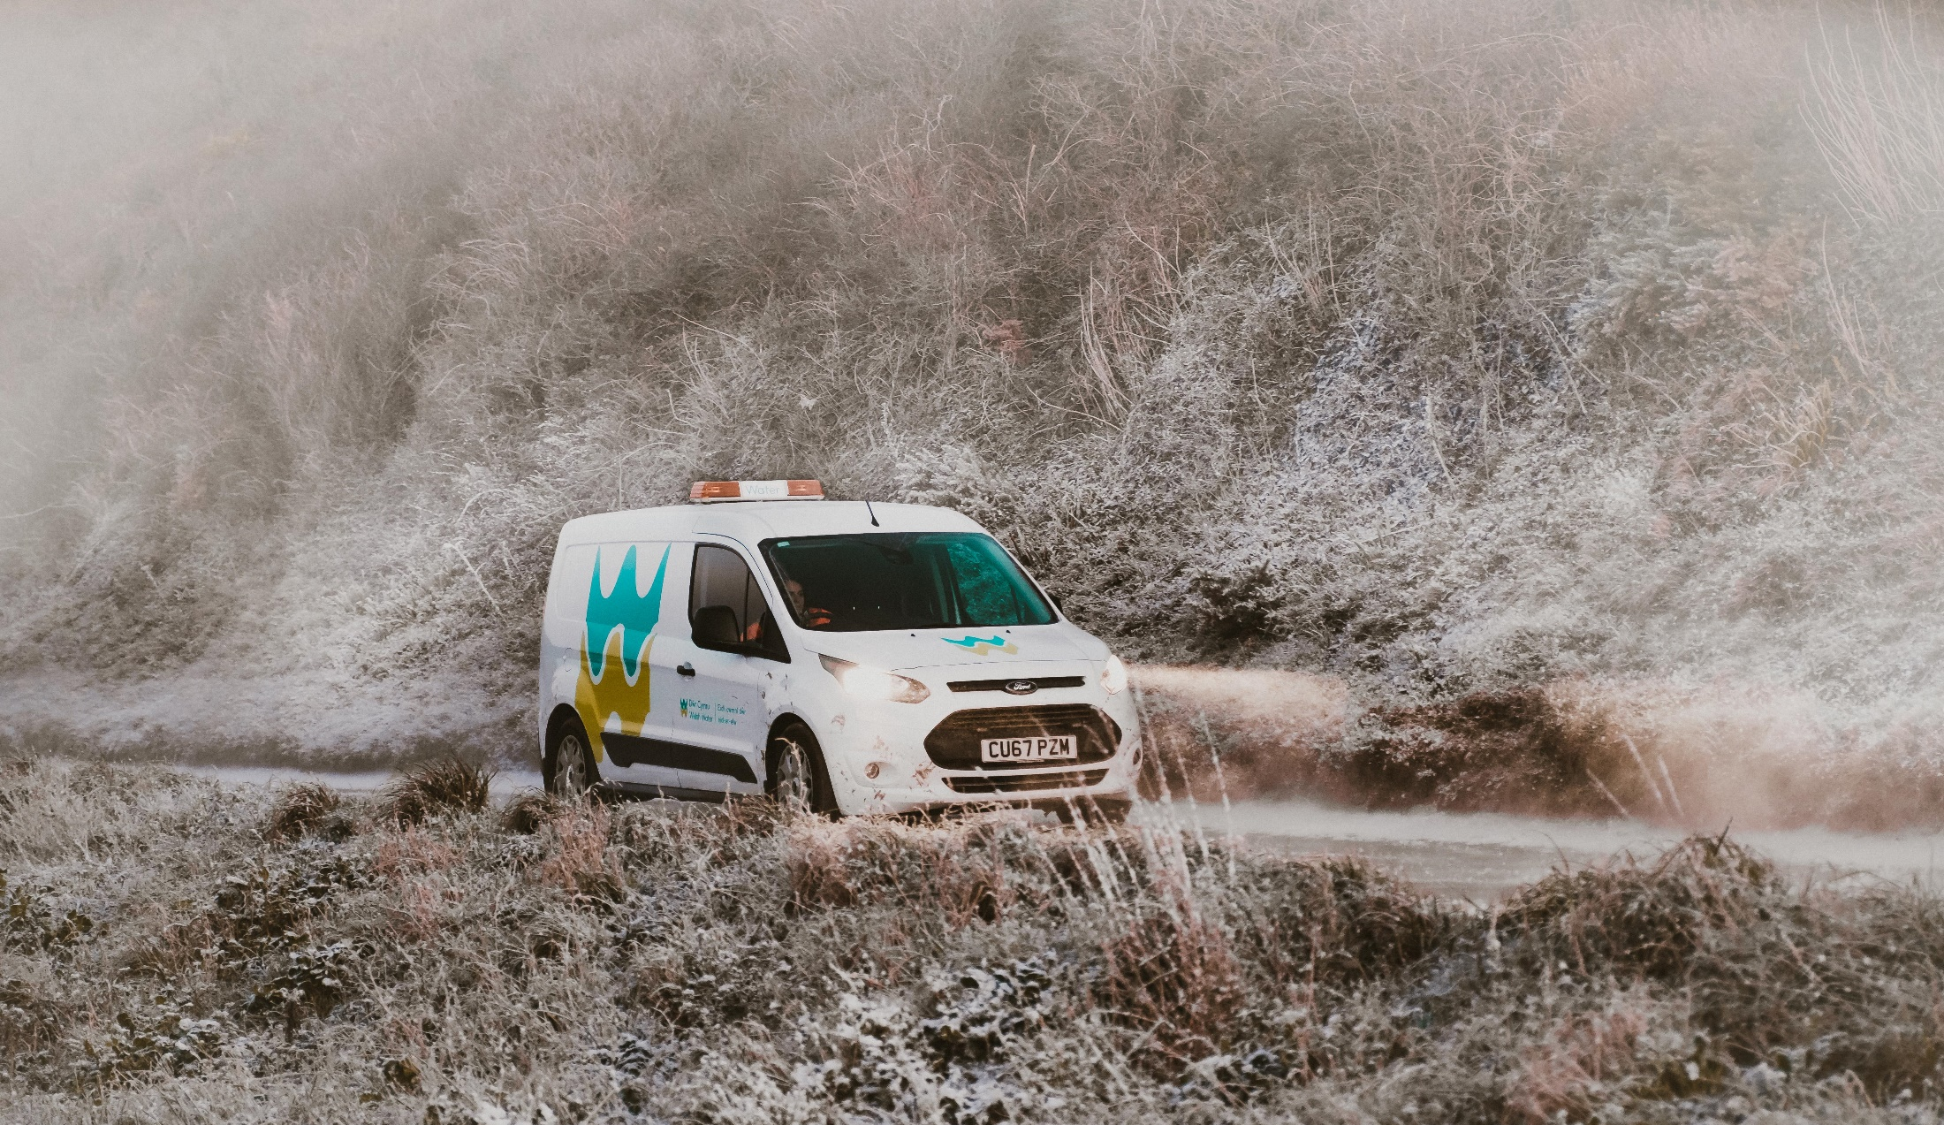
Cwestiynau
Questions

Slide 19

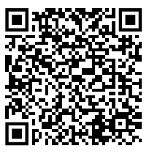
Link - Your water, your say survey - Ofwat

Slide 20
Diolch
Thank you

