Slide 1
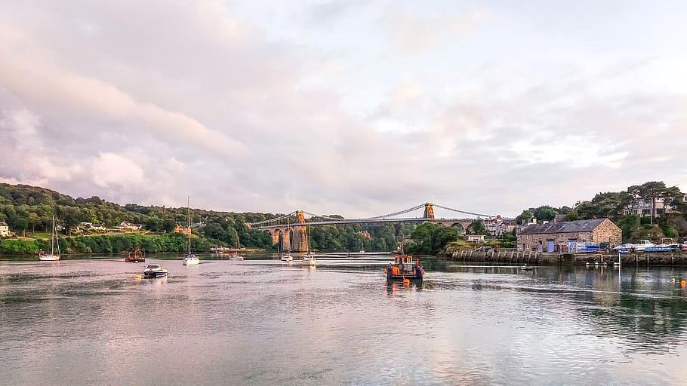
Drainage and Wastewater Management Plan
Report on customer research
September 2020

Slide 2
Executive summary

Slide 3
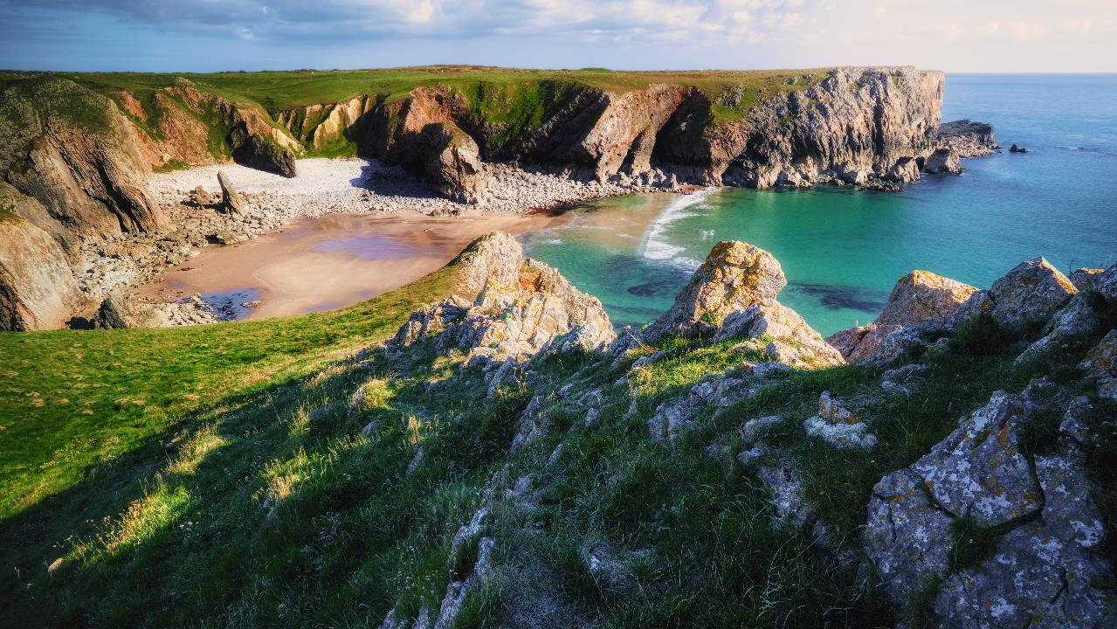
Summary (1/4)
1
Customer awareness and understanding of drainage and wastewater
Customers have very low pre-existing knowledge about drainage and wastewater services.
Understanding of surface water contribution to drainage and wastewater is particularly limited.
When they start to think about it, customers consider wastewater a vital part of everyday life.
While customers are aware of population growth and climate change as major future challenges, they are less aware of urban creep – and for all three challenges, customers are rarely knowledgeable about the implications for drainage and wastewater.

Slide 4
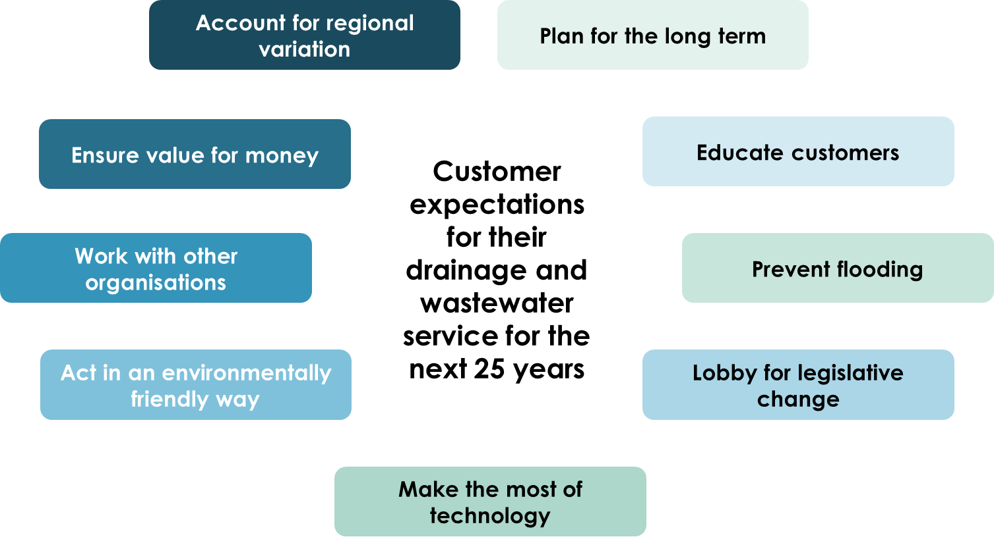
Summary (2/4)
2
Customer expectations of their drainage and wastewater service
With low pre-existing knowledge about drainage and wastewater, customers rarely have specific unprompted expectations about the service they currently receive from DCWW.
Customers also have few unprompted expectations of the drainage and wastewater service that DCWW should deliver in the next 25 years.
Fundamentally, however, customers expect current service levels to be maintained or improved.
Above all, customers trust in DCWW’s expertise to take responsible decisions for the future of the network.
When informed about likely future challenges for the drainage and wastewater network, customers outline a set of clear expectations – these are included on the right.
Expectations once informed of future challenges

Slide 5
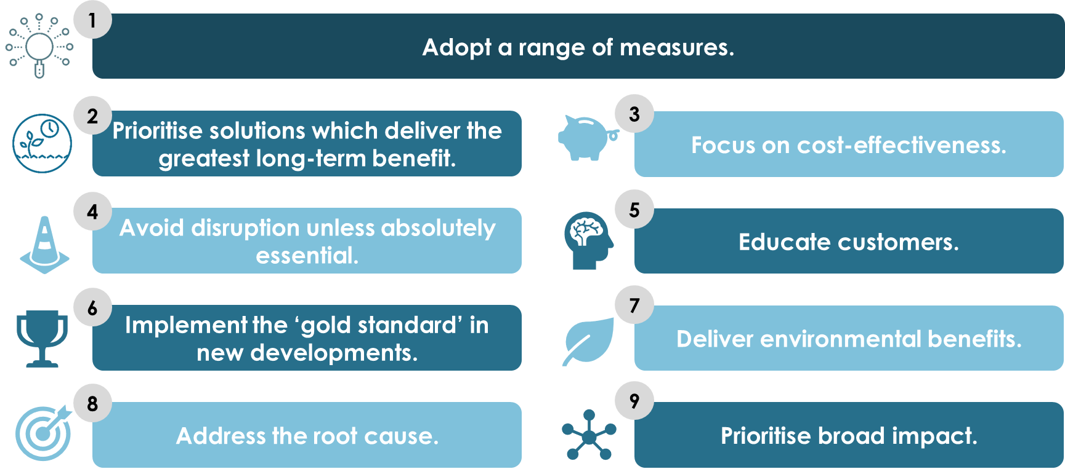
Summary (3/4)
3
Customer views on DCWW’s 25-year plan for drainage and wastewater
Once they were informed about it, customers were positive about the fact that DCWW is planning for the future of wastewater and drainage.
They were reassured that DCWW is adopting a long-term view (they did not typically know that this was a requirement of the regulator), and felt this demonstrated a commitment to stewardship of the network.
Customers also expected DCWW to work with other organisations to achieve change.
Customers outlined a set of principles in relation to how DCWW should invest in the future of drainage and wastewater:

Slide 6
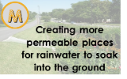
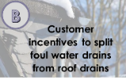
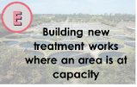
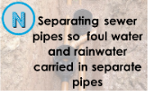
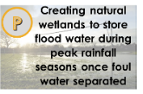
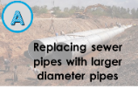
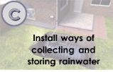
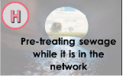
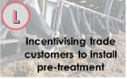
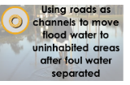
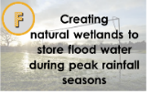
Summary (4/4)
3
Customer views on DCWW’s 25-year plan for drainage and wastewater: possible investments
Most of the investment options that we tested were broadly acceptable to customers.
Very acceptable
Customers see these as priorities for future investment by DCWW.
Moderately acceptable
Customers are divided on these – while some are positive, others strongly dislike each option.
Unacceptable
Customers are very negative about these.

Slide 7
Research objectives and methodology

Slide 8
Brief and objectives
Background
Objectives
Customer awareness and understanding of drainage and wastewater
What do customers know about drainage and wastewater services?
In line with Ofwat guidance, DCWW is currently developing a plan outlining its approach to managing drainage and wastewater for the next 25 years.
DCWW is committed to bringing the voice of the customer into the heart of its business.
DCWW therefore wants to gain early customer input into its plans, to shape the DWMP’s development.
1
Customer expectations of their drainage and wastewater service
What level of service do customers want in terms of drainage and wastewater?
2
Customer views on DCWW’s 25-year plan for drainage and wastewater
What options available to DCWW in terms of drainage & wastewater management do customers want DCWW to prioritise?
3

Slide 9
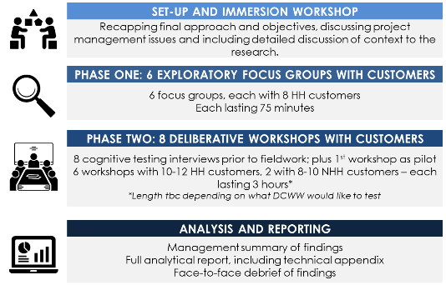
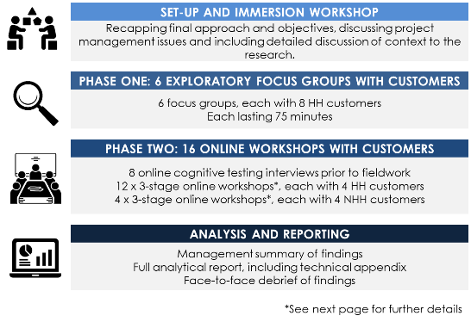
The impact of Covid-19
In January 2020, we began a multi-stage research project in response to the objectives outlined on the previous page. We conducted phase one (exploratory focus groups) face-to-face across Wales before the lockdown. We then adjusted our approach to phase two to ensure that the research was not delayed unduly by Covid-19. The main changes were:
Moving the cognitive testing interviews online (conducting these via video call)
Adjusting the planned 3-hour deliberative workshops to a multi-stage online format (see next page for further details).
Originally planned approach (before Covid-19)
Revised approach (implemented after phase one)

Slide 10
The impact of Covid-19
Revised approach for the deliberative workshops
12 x ‘virtual workshops’, each with 3-4 household customers
4 x ‘virtual workshops’, each with 3-4 non-household customers
Each workshop followed this structure:
1
2
3
1hr group discussion
conducted via video call and moderated by a Blue Marble researcher.
‘Homework’ set at the end of the 1st video group discussion.
Taking up to 1hr to complete.
1hr follow-up group discussion conducted via video call – exploring responses to the homework exercise and building on what had already been discussed.
The impact of the methodological changes:
The online format for the deliberative workshops was a success – respondents were engaged throughout and the bitesize format may have aided this. Comprehension was generally good – customers rarely reported any significant comprehension issues through all 3 stages of the workshops.
It was slightly more difficult to establish a consensus via the online format than it might have been face-to-face – hence the range of customer expectations and principles for investment that are reported later in this document.

Slide 11
Fieldwork timings and sample overview
Fieldwork timings
Phase one – focus groups: 3rd – 4th March
Phase two – cognitive testing interviews: 11th – 18th May
Phase two – deliberative workshops: 22nd June – 12th August
Sample overview: deliberative workshops
Across the core stage of the deliberative workshops, we spoke to a broad range of customers:
12 household workshops
4 non-household workshops
44 household (HH) customers
Locations | 6 x Swansea 6 x Cardiff 5 x Bangor 5 x Hereford 5 x Newport 5 x Rhyl 4 x Abergavenny 4 x Aberystwyth 4 x Pembroke
Billing | Mix of metered and non-metered
Social grade | 25 x ABC1 19 x C2DE
Age | A broad range between 28 and 70
Gender | 24 x women 20 x men
15 non-household (NHH) customers
Locations | 3 x Cardiff 3 x Hereford 3 x Swansea 2 x Bangor 2 x Llandudno/ Colwyn Bay 1 x Newport 1 x Pembroke
Number of employees | 1 x 250 2 x 10-49 12 x 1-9
Estimated annual water bill | 3 x over £5,000 (all over £12,000) 6 x £1,000-£5,000 6 x under £1,000
Types of sectors | Tourism, food, leisure, hospitality Agriculture Professional services

Slide 12
Customer awareness and understanding of
drainage and wastewater

Slide 13
Unprompted understanding of drainage and wastewater
Customers have very low pre-existing knowledge about drainage and wastewater services. Customers are far less familiar with the role of drainage and wastewater services in day-to-day life than they are with water services.
Understanding of surface water’s contribution to drainage and wastewater is particularly limited. Any consideration of the drainage and wastewater system tends to centre on sewage.
When they start to think about it, customers almost always say that wastewater feels very important. It is widely accepted that we ‘take it for granted’, but also that it is essential to modern life.
“I never think about it – other than when things go wrong.”
HH customer
“To be honest, water is just something that we all take for granted. We expect it to be there, no matter how much we use it. I don't think it's something that people really think about.“
HH customer
Non-household (NHH) customers
Awareness and understanding is typically higher among non-household customers than among household customers – but still relatively low.
Some NHH customers are more aware of the role of the drainage network in everyday life, due to impacts on their business – e.g. pub landlords who need to dispose of old stock, or landowners who have had to install pre-treatment. However, this rarely amounts to specialist knowledge – and NHH customers are often no more aware than household (HH) customers of the future challenges facing the network.

Slide 14
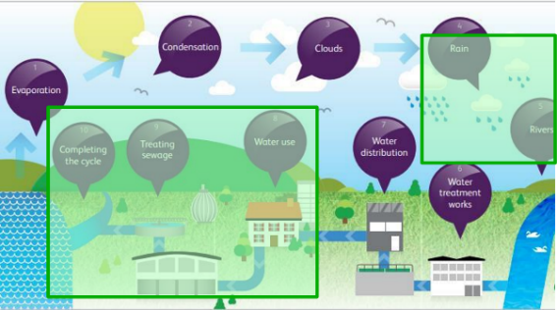
Prompted understanding of drainage and wastewater
Customers readily acknowledge that they are relatively unaware of key details about the wastewater network – including the fact that surface water and foul water enters the same sewerage network, and that many stakeholders have responsibilities in relation to the drainage system.
Among some customers, there is some, limited, awareness of the viability of re-using surface water for gardening, flushing the toilet, etc. – and occasionally an awareness that newbuild properties may have more advanced systems for wastewater management.
Even if customers are aware of specific issues relating to drainage and wastewater (e.g. flooding, which is currently prominent in many customers’ minds after last winter’s floods), they rarely have a detailed understanding of what this means for management of the network.
Non-household (NHH) customers
As with HH customers, NHH customers’ understanding of the drainage and wastewater network is relatively low. They tend to have no idea that surface water and foul water enter the same sewerage network.

Slide 15
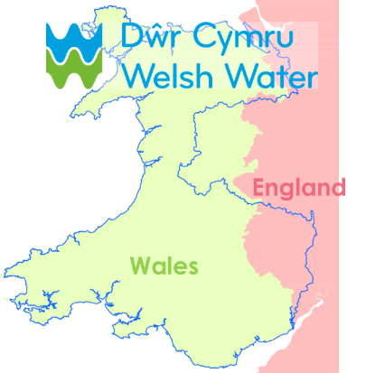
The role of Welsh Water
The role of the water company in managing drainage and wastewater is not very well known. Participants were often only able to articulate vague details about water companies’ involvement in providing drainage and wastewater services.
With their relatively low pre-existing awareness and infrequent experiences of wastewater, most customers assume that DCWW must be managing the drainage and wastewater network effectively.
Broader trust in Welsh Water – and positive experiences of interacting with the company, whether in relation to problems or just through billing – further underpins positive impressions of the company’s management of the drainage and wastewater network.
Non-household (NHH) customers
NHH customers tend to have similarly positive impressions of DCWW. In some cases, this is driven by increased personal contact – for example, in relation to specific water supply issues which are business-critical (e.g. for a catering firm). This contact has rarely been specifically in relation to wastewater.
“I know Natural Resources Wales are the spearhead for Wales in terms of the environment. How much Welsh Water does, I don’t know.”
HH customer

Slide 16
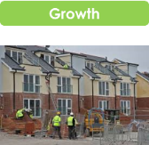
Awareness of future challenges for drainage and wastewater
Customers are relatively unaware of the key challenges facing DCWW in terms of managing the drainage and wastewater network over the medium and long term.
Customers are usually vaguely familiar with the challenges of population growth and climate change at an abstract level, although the challenge of urban creep is less well known.
However, customers are rarely familiar with – nor able to articulate – the implications of these challenges for the drainage and wastewater system without prompting – indicating that DCWW will need to work hard to inform customers of the challenges it faces and ensure widespread buy-in to its plans.
"I knew the network of pipes would eventually get strained - it's an old system. But I'd never thought about how today's society would have an effect on it, with so many housing estates going up left, right and centre.”
HH customer
“Adding conservatories, adding new driveways – I didn’t associate that with water.”
HH customer
"It's absolutely astonishing - I couldn't believe that I'd never thought about these things before.”
NHH customer

Slide 17
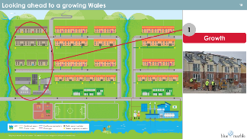
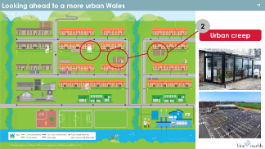
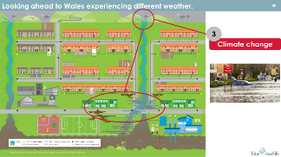
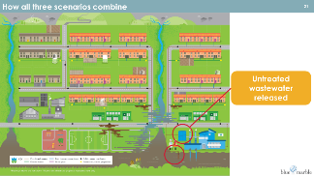
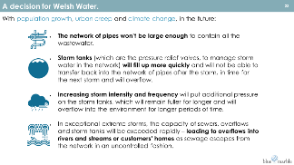
Information provided to customers about future challenges
In each workshop, we provided information about likely future challenges for drainage and wastewater – so that we could understand customers’ informed perspectives on how Welsh Water should respond. A selection of the information we presented to customers is included below. Most slides also included accompanying explanatory commentary from the moderator, which is not included here.

Slide 18
Understanding of future challenges for drainage and wastewater
Despite their low pre-existing awareness of these implications, customers immediately understand and accept the information presented about what the challenges mean for the network – with almost no customers rejecting this.
Once informed of the implications for drainage and wastewater, customers fully endorse the fact that DCWW (and other stakeholders) must take action to address them – these implications feel like a logical extension of the challenges that customers were already aware of.
Customers expect that DCWW will not be alone in trying to tackle these problems – and understand that they are society’s problems too. Customers want DCWW to work together with other organisations to address the challenges identified, but often have a very limited understanding of the range of actors involved or of the complexities that such cooperation may entail.
“They [Welsh Water] just need to invest to find ways around this.“
NHH customer
"It's not just Welsh Water's job - it's everybody’s.”
HH customer
Non-household (NHH) customers
NHH customers are similarly understanding of the need to act in the face of future challenges. However, they are often more pragmatic in how they think DCWW should respond – wanting DCWW to balance ideals with cost-effectiveness and limiting disruption – and more aware of the likely challenges of working with other organisations to implement change.

Slide 19
Customer expectations of their
drainage and wastewater service

Slide 20
Current service levels
With their low pre-existing knowledge about drainage and wastewater, customers rarely have specific unprompted expectations about the service they receive from DCWW.
Indeed, many customers immediately default to talking about water supply priorities because this is more familiar to them.
Customers tend to report being broadly happy with the drainage and wastewater service that they currently receive – primarily because few of them recall experiencing any problems with their water and wastewater service.
When they are asked to think about it further, customers’ unprompted expectations for the drainage and wastewater service that DCWW provide include:
flood prevention, which emerged repeatedly as a major theme of conversations, shaped by personal experiences of flooding last winter. We have included further discussion of the reported importance of flooding – see later in this section.
network maintenance, partly because customers expect the service they receive to stay the same or improve (and not worsen) and partly because DCWW is seen to have a moral duty as custodian of the water and wastewater network for future generations.
planning for the long term, for the same moral reasons.
“I didn't realise how archaic the water system is.”
HH customer
“Flooding is the paramount issue, really. [...] If anywhere is flooding in 10 years' time, you've almost wasted your time and money in anything you're trying to upgrade.”
NHH customer

Slide 21
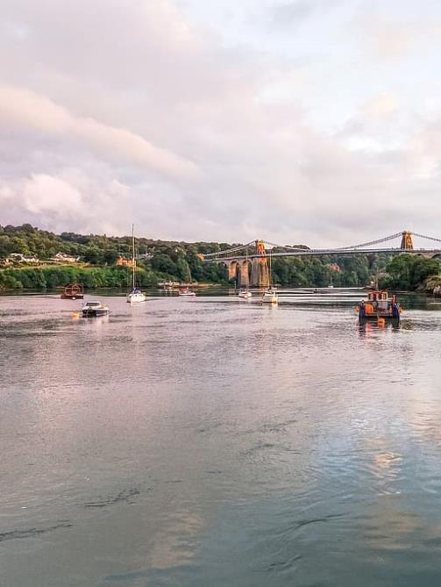
Planning for the next 25 years
Customers have few unprompted expectations of the drainage and wastewater service that DCWW should deliver in the next 25 years.
Fundamentally, customers expect current service levels to be maintained or improved. Few recall experiencing issues with their drainage and wastewater service.
Above all, customers trust in DCWW’s expertise to take responsible decisions for the future of the network.
This is based on the understanding that DCWW’s staff are experts with a strong interest in taking the right long-term decisions for Wales’ water and wastewater network, they are happy to place key decisions in DCWW’s hands.
“We've got to trust them to know what they've got to do - we don't know. If they say, 'We've got to do this, this and this', then fair enough - crack on.“
NHH customer

Slide 22
Planning for the next 25 years: customer expectations
Once informed about likely future challenges for the network and about the fact that DCWW is developing a 25-year plan, customers outline a set of broad expectations.
Account for regional variation
Plan for the long term
Customer expectations for their drainage and wastewater service for the next 25 years
Educate customers
Ensure value for money
Work with other organisations
Prevent flooding
Act in an environmentally friendly way
Lobby for legislative change
Make the most of technology

Slide 23
Planning for the next 25 years: customer expectations
Customer expectations for their drainage and wastewater service for the next 25 years (1/3)
Plan for the long term
Educate customers
Prevent flooding
Customers want DCWW to take a long-term view on what is right for the network and for customers.
Customers often frame this in moral terms, with DCWW seen as custodians of our water and wastewater system for future generations.
Customers say they want DCWW to prioritise prevention over cure.
Many are shocked by the information presented during the workshops about the challenges facing the wastewater system.
They think more should be done to educate the wider public about the need for action.
They also want DCWW to tell customers what they can do individually to help tackle the problems identified.
As already highlighted, this is seen as a key priority, particularly in the context of recent flood events.
“We should have a system where it's absolutely impossible for sewage to float back up. There's no real excuse for raw sewage to be coming back up really.“
HH customer
“Something needs to be done with a long-term view in mind to fix the long-term problem.”
HH customer
“[Welsh Water] needs to communicate to make more people aware of what’s going on.”
HH customer

Slide 24
Planning for the next 25 years: customer expectations
Customer expectations for their drainage and wastewater service for the next 25 years (2/3)
Lobby for legislative change
Make the most of technology
Act in an environmentally friendly way
Customers are very receptive to the idea that effective change can be achieved through legislative steps.
Changing building requirements for developers is seen as a key first step.
Some customers feel that DCWW is not maximising technological advances for the benefit of the drainage and wastewater network, based on the information provided during the workshops – specifically the presentation of “using technology” as a future investment option.
Customers want a smarter sewerage network, as well as early warning systems for flooding, or more intelligent weather monitoring.
Customers see DCWW as a major environmental player.
An expectation that DCWW should take environmentally responsible decisions is often a broader overarching theme of conversations with customers.
It often underpins the choice of individual investment options.
"We need to legislate and say that this is now a legal requirement. There are tons of building regs, and this would just be added in.”
HH customer
"Many businesses [...] have to focus on their environmental footprint, and Welsh Water shouldn't be any different. Their long-term plan should have the environment as one of the top priorities.”
HH customer
"Technology is going to improve over the next 25 years.”
HH customer

Slide 25
Planning for the next 25 years: customer expectations
Customer expectations for their drainage and wastewater service for the next 25 years (3/3)
Work with other organisations
Ensure value for money
Account for regional variation
Collaboration is seen as essential to meaningful change.
Customers often assume that it will be easy for organisations to collaborate effectively on this issue.
Customers want DCWW to invest where necessary but keep bills affordable.
They also expect other key actors to fund change where appropriate – e.g. developers should cover the cost of meeting new building regulations and polluting businesses should be forced to pay for installing pre-treatment where appropriate.
Customers are often very aware of regional differences across Wales (and the broader Welsh Water area). Customers in rural areas are often particularly keen for a regionalised approach to the plan – fearing a “one size fits all” strategy.
“To get the problem solved, [all water companies] need to be working together. […] It’s got to be a national solution.”
NHH customer
“It can't be a one size fits all solution because that's not the nature of where we live. It's common sense.”
NHH customer
“All of these are going to end up being paid for by the customer, so I like [pre-treating sewage] because [...] it's cost effective in the short term compared to most of the other options.”
HH customer

Slide 26
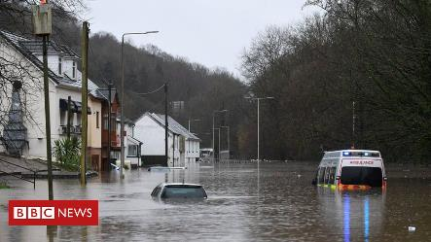
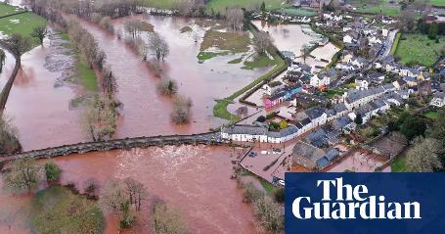
Methodological consideration: the importance of flood prevention
!
Methodological consideration
The importance of flooding may have been overstated by customers in this research, due to the proximity of recent flooding events.
Flood prevention consistently emerged as a core theme of conversations with customers in this research. Many saw this as a major responsibility for DCWW’s future plans.
Customers were often explicit about the importance of last winter’s floods in shaping their views on this – and, unsurprisingly, views were strongest among those who had been personally affected by the flooding.
A high proportion of our respondents had had some personal experience of last year’s floods – e.g. because their property or business had flooded, areas near them had flooded or because friends / family members had been flooded.
Given the long-term focus of the DWMP, we recommend taking a nuanced view of this reported importance.
While flooding is clearly an important issue for customers (and a rare conscious touchpoint with the drainage and wastewater network), its importance relative to other DWMP issues is likely to be lower than stated in this research.

Slide 27
Customer views on DCWW’s 25-year
plan for drainage and wastewater
Notes:
Section 4: 10 minutes
We’ve now looked at a few different decisions facing Welsh Water. Thinking back on everything we’ve looked at…
What do you want Welsh Water to prioritise as it plans for the next 25 years?
Which, if any, of the options that we looked at felt very important to prioritise? Why?
And which, if any, felt very important to avoid? Why?

Slide 28
Views of the 25-year plan
Once they were informed about it, customers were positive about the fact that DCWW is planning for the future of wastewater and drainage.
They were reassured that DCWW is adopting a long-term view (they did not typically know that this was a requirement of the regulator), and felt this demonstrated a commitment to stewardship of the network.
Customers also expected DCWW to work with other organisations to achieve change.
This was driven by a belief that any plans will be most effective if agreed and acted upon by many parties.
And also by the view that planning for a sustainable future of drainage and wastewater is not just DCWW’s responsibility – but also the responsibility of many organisations. Customers felt that this is “society’s problem, rather than just Welsh Water’s”.
However, customers tended to anticipate that such cooperation would be straightforward in practice.
"It's such a vast, vast, almost impossible situation for Welsh Water alone.”
NHH customer
"It's not feasible for Welsh Water to deal with the next 25 years...without some kind of conversation with every other industry or sector that it's going to impact on.”
NHH customer
Non-household (NHH) customers
NHH customers are similarly positive but also pragmatic about the likely challenges of working with other organisations. They also tended to have a more pragmatic response to the investment options – e.g. seeing a role for flood gates in mitigating the very worst effects of flooding, if it this wasn’t seen as the “ideal” solution.

Slide 29
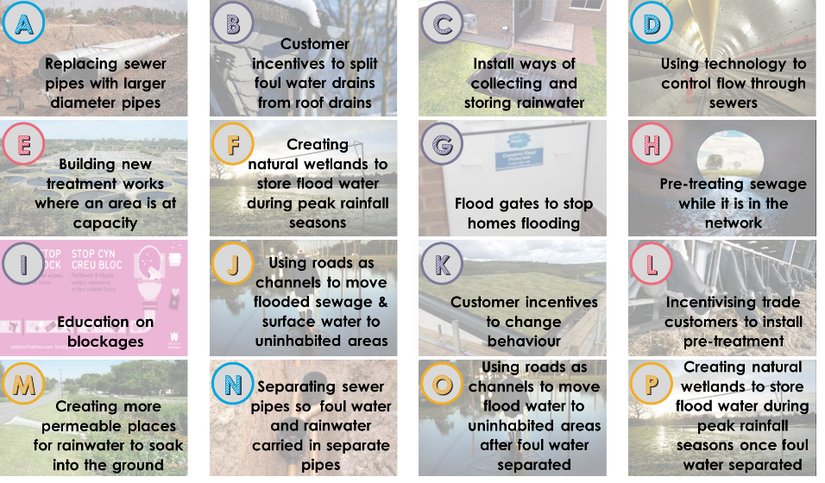
Customer principles for investment
We tested 16 investment options with customers, to understand which they preferred, and how acceptable each was. The full stimulus materials for each investment option are included at the end of this document.
!
Methodological consideration
We intentionally excluded references to cost from the stimulus materials. However, cost-effectiveness repeatedly emerged as a key priority for customers and some made assumptions (which may be incorrect) about the relative cost-effectiveness of different investment options. Further research is required to understand how customer preferences change once cost is included.

Slide 30
Customer principles for investment
Across the 16 customer workshops that we conducted, some clear customer principles emerged in relation to how DCWW should invest in the future of drainage and wastewater:
1
Adopt a range of measures.
2
3
Prioritise solutions which deliver the greatest long-term benefit.
Focus on cost-effectiveness.
4
5
Avoid disruption unless absolutely essential.
Educate customers.
6
7
Implement the ‘gold standard’ in new developments.
Deliver environmental benefits.
8
9
Address the root cause.
Prioritise broad impact.
Further detail is provided on the following slides.

Slide 31
Customer principles for investment
1
2
Adopt a range of measures.
Prioritise solutions which deliver the greatest long-term benefit.
Customers believe that a range of complementary solutions will be the most effective way to tackle the key challenges of growth, creep and climate change:
It mitigates the risk of any one intervention failing and the overall plan therefore not working.
It allows for a balance of innovative approaches with tried and trusted methods.
It allows for regional variation – choosing the most appropriate schemes for specific regions.
“I’m a big fan [of creating permeable surfaces]. This can be done over the long term."
HH customer
Customers want DCWW to prioritise the long-term health of the drainage and wastewater network, rather than chasing quick fixes:
This is seen as a moral responsibility – with DCWW viewed as custodians of the wastewater network for future generations.
It is also seen as a clear advantage of DCWW’s monopoly status.
Customers say that they want “prevention, rather than cure”.
Customers expect DCWW to take strong decisions based on its expertise, and absolutely do not want the company to “kick the can down the road”.
“Not one of them is the right answer – it’s a little bit of each.”
HH customer
"It's got to be a mix and match exercise."
HH customer

Slide 32
Customer principles for investment
3
Value for money and effectiveness are essential for customers – albeit not at the expense of environmental considerations. Customers expect all DCWW’s decisions to be environmentally responsible ones.
Customers tend to trust DCWW’s judgement on evaluating the cost-effectiveness of different interventions.
Focus on cost-effectiveness.
“Fixing pipes is more cost-effective [than using technology better].”
NHH customer
4
Measures likely to cause significant disruption to everyday life, such as laying new pipes, should only be implemented where they are considered absolutely necessary.
Customers place a strong emphasis on being opportunistic to avoid unnecessary disruption – e.g. splitting out pipes when they are damaged or due for an upgrade, rather than specifically digging up roads to do this. This is particularly true in South Wales, where traffic is already seen as a major problem and potential disruption is emotive.
Avoid disruption unless absolutely essential.
“The traffic in South Wales is so bad anyway.”
HH customer

Slide 33
Customer principles for investment
5
6
Educate customers.
Implement the ‘gold standard’ in new developments.
Many customers found the challenges facing the network shocking and expect DCWW to raise awareness among the wider customer base.
Despite enthusiasm to educate about the challenges, customers are often hesitant about the likely effectiveness of customer-side solutions (behaviour change) – having little faith in others to act responsibly. However they consider these solutions a good way of raising awareness.
Education of school-aged children about these challenges is widely considered essential for long-term change.
"A lot of it has got to be done through regulations to change all these new builds to take their own volume of water.”
HH customer
While customers expect some measures are likely to be difficult and costly to implement in existing communities, they want future developments to meet the gold standard in drainage and wastewater management.
“Incentives are a good way to educate customers.”
HH customer

Slide 34
Customer principles for investment
7
8
9
Deliver environmental benefits.
Address the root cause.
Prioritise broad impact.
Most like to see environmental benefits but this often only emerges when prompted – and can also point to other (stronger) benefits e.g. lower cost, low disruption or visually attractive solutions. Positive environmental aspects can encompass:
A natural solution (floodplains)
Positive for wildlife (retaining or creating habitats)
Recycling (grey water)
Preventing pollution
Customers were most positive about solutions that tackled the problem head on rather than anything perceived to be stopgap or temporary.
This was especially true of solutions to mitigate urban creep – the challenge they were least familiar with but the area they felt was ‘man-made’ and more solvable.
Customers are wary of solutions that may only be accessible to people who have the space or money to benefit e.g. grey water systems. Aware that the investment is paid for by everyone, there is a greater desire for solutions which will directly or indirectly benefit all.
“Not worth the investment in the tech if only an intermediate solution.”
NHH customer
“I think the priorities need to be the ones that have got the widest benefit to the most people, the ones that have the least impact on the environment.”
NHH customer
"I’ve not been especially concerned about the environment but as an average Joe Bloggs, I just take more interest these days.”
NHH customer
“This will counteract urban creep.”
NHH customer

Slide 35
Review of options by category
Surface water treatment
Some surface water treatment options are initially attractive to customers, but many have questions about the practicalities when they consider them in more detail.
Customers question how effective solutions such as water butts and storage tanks will be, particularly if implemented at an individual rather than community level.
Surface water solutions tend to be most popular with more environmentally-conscious customers, but even they rarely think that these interventions will be enough on their own.
Customer-side solutions
Customers are often sceptical about the likely effectiveness of these, in part because they feel more complex and less guaranteed than a large, DCWW-led intervention such as a major infrastructure project.
However, customers often think that these solutions are a good way of raising awareness of the key challenges facing the water and wastewater network.
Some customers would prefer a “stick” rather than “carrot” approach, with fines for irresponsible behaviour.
Wastewater treatment
Customers’ views on new technology – such as pre-treating sewage – are polarized. Some think innovation is essential to solve the key issues, while others worry that such interventions will not work.
Any investment in new technologies (e.g. pre-treatment of sewage) will need to be managed carefully (e.g. through experimental initial projects) to keep all customers happy.
Managing sewer systems
Customers worry that some measures – e.g. installing larger pipes and using technology – will simply be stopgaps and not actually resolve the fundamental challenges.
Separating pipes is seen as the ideal but also impractical to implement across the DCWW region.

Slide 36
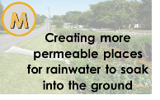
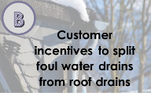
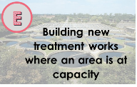
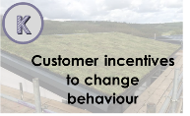
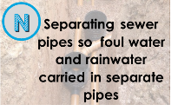
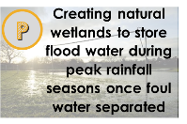
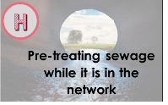
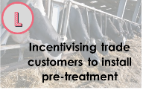
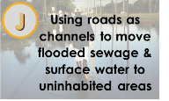
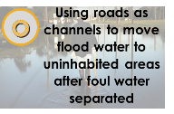
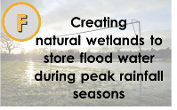
Acceptability of specific individual options
Most of the options that we tested were broadly acceptable to customers.
Very acceptable
Customers see these as priorities for future investment by DCWW.
Moderately acceptable
Customers are divided on these – while some are positive, others strongly dislike each option.
Unacceptable
Customers are very negative about these.

Slide 37
Very acceptable solutions
Customers see these as priorities for future investment by DCWW.
Perhaps the most popular of all options, this is considered easy, non-invasive, environmentally friendly and effective.
Popular, although often considered a stopgap. Making the most of technology considered an essential “hygiene factor” for a large company.
Widely liked – although some question how effective this would be in practice. Essential for newbuilds.
Considered inevitable given population growth, although not addressing the core challenge (increasing wastewater volumes).
Education always popular. Some want this to be broader, as not seen to address core challenge.
Popular, although likely impact questioned. Potentially a “middle-class” solution.
Essential for new developments, Limited appetite for retrofitting unless as part of ongoing maintenance.
Positive reaction. Public health risk of unseparated foul water option is unacceptable.

Slide 38
Moderately acceptable solutions
Customers are divided on these – while some are positive, others strongly dislike each option.
Divisive. While some see this as a safe, straightforward investment, others consider it a disruptive stopgap which does not address the real issues.
Divisive. Initially popular, but practical questions abound and cause some to question effectiveness.
Some see this as sensible contingency planning for worst affected areas – others consider it “giving up” and morally wrong.
Some nerves around untested technology, as well as environmental concerns about excess chemicals in the network.
Considered likely to have a major impact. Customers want trade customers to bear the cost of this.

Slide 39
Unacceptable solutions
Customers are very negative about these.
Widely considered unacceptable. Customers do not see this as a solution – it does not feel as though DCWW is in control of the process and therefore feels unmanaged.
Both are thought to impose unacceptable disruption on specific groups and communities (e.g. disabled groups, families with young children, communities through which the sewage passes).
The public health risk of the unseparated sewage is an emotive issue. Customers think this is not a modern or forward-thinking solution.
Public health risk of unseparated foul water option is unacceptable.

Slide 40
Acceptability of specific individual options
Very acceptable solutions
Customers see these as priorities for future investment by DCWW.
!
Methodological consideration
We intentionally excluded references to cost from the stimulus materials. However, cost-effectiveness repeatedly emerged as a key priority for customers and some made assumptions (which may be incorrect) about the relative cost-effectiveness of different investment options. Further research is required to understand how customer preferences change once cost is included.

Slide 41
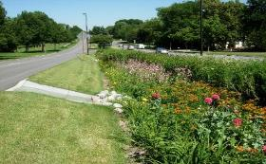
Investment options: customer feedback
M
"I think the long-term option is M [creating more permeable places]. With a lot of new developments, there's the opportunity to implement this."
Creating more permeable places for rainwater to soak into the ground
Positive customer feedback
Negative customer feedback
Creation of green space very popular
Clearly mitigating the effects of urban creep
Long term option
Strong support for inclusion in new builds/urban spread as a matter of course, and within resurfacing of existing roads
Tried and tested
Natural solution, environmentally friendly
Fewest negative comments of all options
Query over durability and ongoing maintenance
Not possible in every location
Consensus: Very acceptable, joint highest approval rating and fewest negative comments
This option was the most popular overall, with respondents finding the creation of green space
very appealing and noting that there were few drawbacks.

Slide 42
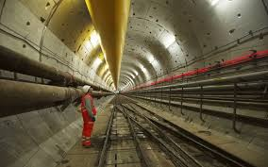
Investment options: customer feedback
D
Negatives
"You should start using your technology - that way you can maximise your use out of your new pipes."
Using technology to control flow through sewers
Positive customer feedback
Negative customer feedback
Technology is essential to get the most out of system – good to use alongside other options
Low disruption
Reduces risk of human error
Good short-term fix using existing infrastructure while more effective methods investigated
Lack of understanding of how this would work and the implications/benefits
Not a long-term solution
Does not address root cause
Carries heavy risk if system crashes
Consensus: Very acceptable, but seen as a step DCWW should already be taking
Although widely accepted, many customers see this as a ‘hygiene factor’ – failing to make the most of technology is almost seen as negligent by some.

Slide 43
Investment options: customer feedback
B
“My neighbour has a water butt which collects rain water from the gutters although apart from watering the garden in the summer I'm not sure what else it can be used for.”
Customer incentives to split foul water drains from roof drains
Positive customer feedback
Negative customer feedback
Incentives popular and attractive; tangible benefit for customers would drive uptake
Reduces costs to the customer
Technology to split water should be legislated so it is installed in newbuilds as standard (putting responsibility for solving drainage issues on developers rather than consumers)
Familiar approach; comparisons with solar panel scheme
Costly
Unfair; only privileged people can afford to do this
Lack of understanding of implications e.g. think roof drain water can only be used for watering garden
Many assume option includes separate pipes underground and have not considered that there may not be separate pipes for it
Consensus: Very acceptable, with few rejecters
An attractive option for many, with the focus on the incentivisation element, which people saw as being key to ensuring customer involvement. Few rejecters.

Slide 44
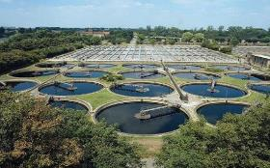
Investment options: customer feedback
E
"The more population you have the more impact on everything around it […] the sewage plants are going to have to be increased to cover the amount of people."
Building new treatment works where an area is at capacity
Positive customer feedback
Negative customer feedback
Feels like a genuine investment in improving the network which is familiar and reliable
Inevitable – increased processing capacity will be required as population grows
Long(er) term solution
Low cost vs impact generated
High impact
Targeted support for problem areas and benefits all
Low disruption (particularly vs replacing pipes)
Short(er) term solution
Does not address root cause
Odour
Not in my backyard!
Could affect house pricing and the environment surrounding the factory
Consensus: Very acceptable
This option is favoured because it feels simple and appears to be a logical next step for the network,
whilst being less disruptive and costly than building larger pipes.

Slide 45
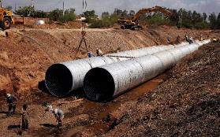
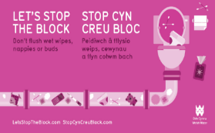
Investment options: customer feedback
I
"Education is key. Using social media, flyering campaigns, etc. will educate people, but I thought a lot of the flooding was associated with rainwater […] we didn't really talk much about blockages in sewers. It's a good side addition to a long-term plan."
Education on blockages
Positive customer feedback
Negative customer feedback
A nice to have, but not essential. Seems like the right thing to do and supports all other options
Drives behavioural change by helping customer understand consequences of actions and benefits of acting differently
Environmental focus increasing, particularly amongst younger generations, so starting with them would have most impact
Empowering for customers
Perceived low impact as relies on customer engagement
Already happening but obviously not working
Blockages too narrow a subject to focus on
Consensus: Very acceptable, supporting all other options
Whilst most thought education was a positive step, many were not passionate about this option, perceiving it to be low impact and something that would support other options rather than bring about largescale change

Slide 46
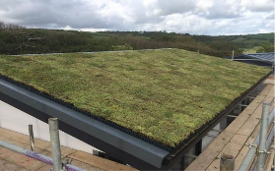
Investment options: customer feedback
K
“It’s like collecting Morrison’s points. People are going to do it because you get something back at the end.“
"It would give money to those who are already more privileged with their nice gardens and their space to put their butts. Whereas the lower income people who live in flats and high rises couldn't share it, it would be unfair.“
for example by changing behaviour of grey water use separating roof run-off from foul."
Customer incentives to change behaviour
Positive customer feedback
Negative customer feedback
Incentives popular and attractive; tangible benefit for customers would drive adherence
Incentives necessary to effect behaviour change
Reduces costs to the customer
Low impact - small water savings won’t be enough to move needle on issue
Incentives unfairly benefit privileged
Confusion between reducing water usage and reducing waste-water
Unfair for those already moderating water usage
Consensus: Very acceptable
An attractive option for most, with incentives playing a key part in ensuring customer involvement in
reducing waste water. Few rejecters, although concerns that impact would be low.

Slide 47
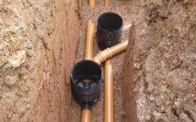
Investment options: customer feedback
N
Separating sewer pipes so foul water and rainwater carried in separate pipes
"I like the thought of it being more economical, but it's going back to the thought of digging up the roads."
'It's a must. This is the next evolution of how drainage should work - it should just be taken.”
Positive customer feedback
Negative customer feedback
The ideal solution, requiring high effort upfront but yielding the best long-term results
Seen as a logical solution
Strong support for construction during development of new settlements (as opposed to retrofitting)
Environmentally friendly
Relies on technology rather than customer input
Cost would be recouped by more efficient operations i.e. not treating rainwater
Extremely disruptive
Costly
Time consuming and a lot of work to implement
Not feasible to replace the entire network
Risk of chemicals entering grey water is unnerving – requires education of customers
Potential environmental impact from work
Consensus: Very acceptable, although time / cost required to implement reduces appeal
Although this was seen as an ideal measure to manage drainage and wastewater in the long-term, the anticipated cost and disruption of installing the new pipes is seen as a challenge.

Slide 48
Investment options: customer feedback
P
Creating natural wetlands to store flood water during peak rainfall seasons (once foul water separated)
NB. This was tested as part of a pair – responses to the separated option (option F) are included on a separate slide.
“It’s good because it stops building in flood plains.”
Positive customer feedback
Negative customer feedback
Natural solution
Quick, cheap and simple to implement
Creates new environments for wildlife
No major disruption
Prevents building on natural flood plains
Perception many areas in Wales are suitable
Don't want to prevent usage of leisure facilities
Uses land which could be used for homes
Doesn’t address root cause of flooding
Consensus: Very acceptable as part of a wider range of options (and foul water separated)
Although not a stand-alone solution, the separated option (option F) appealed as a natural solution that is quick, simple and easy to implement – but only if foul water has been separated.

Slide 49
Acceptability of specific individual options
Moderately acceptable solutions
Customers are divided on these – while some are positive, others strongly dislike each option.
!
Methodological consideration
We intentionally excluded references to cost from the stimulus materials. However, cost-effectiveness repeatedly emerged as a key priority for customers and some made assumptions (which may be incorrect) about the relative cost-effectiveness of different investment options. Further research is required to understand how customer preferences change once cost is included.

Slide 50
Investment options: customer feedback
A
“Increasing the size of the pipes sounds like an obvious one that I don't think you could avoid, even though it sounds quite disruptive."
Replacing sewer pipes with larger diameter pipes
Positive customer feedback
Negative customer feedback
Feels like a genuine investment in improving the network which is familiar and reliable
Inevitable – sewer network old and failing so will need to be replaced anyway as population grows
Could replace pipes while constructing new settlements, or doing other roadworks
Suitable alongside other solutions - natural partner to using technology and building new treatment works
Puts responsibility for solving drainage issues firmly on Welsh Water rather than individuals
Extremely disruptive – major barrier for many
Costly
Does not address root cause
Not a long-term solution; ‘a false economy’ because it must be redone in future
Time consuming
Not feasible in all areas
Consensus: Moderately acceptable, but the most divisive
Whilst many favour this option because it is tangible and appears to be a logical next step for the network, more are put off by the disruption it would cause to everyday life.

Slide 51
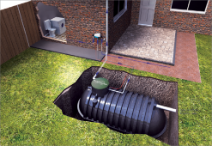
Investment options: customer feedback
C
"If it became part of new housebuilding regulations that it had to be done, then I think it would have a great impact."
Install ways of collecting and storing rainwater
Positive customer feedback
Negative customer feedback
Reusing grey water is logical and appealing
Savings on water bill appealing to those on meter
Drives awareness of water usage
Allows customer to feel like they are playing a part in solving problem
Could this be a community level solution?
Technology to collect and store water should be legislated so it is installed in newbuilds as standard (putting responsibility for solving drainage issues on developers rather than consumers)
Disruptive – reject idea of having garden dug up
Low impact as small capacity
Not suitable for many people due to space
Expensive
Unfair; only privileged people can afford to do this
Relies on consumer input – could forget or not bother
Perceived low uptake without an incentive
Assume that if a tank is present, will be able to use greywater in house (when this may not be the case)
Consensus: Moderately acceptable, but fairly divisive
Although in theory using greywater is very appealing to many, the practicalities of installing and using the technology put many people off this option, particularly if no incentive is offered.

Slide 52
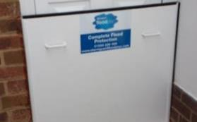
Investment options: customer feedback
G
"Anything that prevents property damage is going to be a good idea.“
“It might stop it at the door; but it won't stop it seeping through the foundations.“
Flood gates to stop homes flooding
Positive customer feedback
Negative customer feedback
Cost-effective, targeted protection for homes in flood-prone areas
Commonly seen as a good idea because could save a home from flood destruction
Protects people’s homes and makes them insurable and therefore sellable
‘Better than sandbags’, but a last resort
Does not address root cause of flooding
Not a long-term solution
Sceptical about effectiveness – does not prevent damage if over door height/through foundations
Perception that the homeowner is responsible for this rather than Welsh Water
Not relevant to most homes
Not a good selling point for a house
Consensus: Moderately acceptable, but fairly divisive
This option divided opinions; some thought it was an effective way of protecting at-risk properties, but many thought that money could be more productively spent on preventative measures.

Slide 53
Investment options: customer feedback
H
"It can't be carried out on a mass scale until it's been tested. It sounds like there are some risks involved, so if there's a trial and it works, then it could be implemented."
Pre-treating sewage while it is in the network
Positive customer feedback
Negative customer feedback
Water has had some treatment if it needs to be released in extreme conditions
Seems like an easy way to relieve pressure on plant
Cost effective in short-term
Will improve as technology improves
Use of technology is a positive thing
Kills rats
Unfamiliar – people don’t know what to make of it
Chemicals are alarming
Unknown consequences for environment – fears over contamination of drinking water or groundwater
Confusion over what option would entail – would treated water go straight to peoples’ homes?
Does not address root cause
Nb. Many groups did not mention this option spontaneously, reflecting a lack of understanding of what it would entail
Consensus: Moderately acceptable, but fears over consequences would need to be addressed
Whilst this seemed to many to be a simple and effective solution for relieving pressure on the system,
alarm over the potential consequences of the pre-treatment put many off

Slide 54
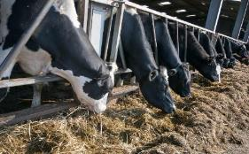
Investment options: customer feedback
L
Incentivising trade customers to install pre-treatment
"Farmers love grants."
Positive customer feedback
Negative customer feedback
Incentives would make this an attractive option to trade
Uptake would be boosted because it would make businesses appear ethical – could be granted a logo or accreditation?
Would ensure farmers manage nitrates/waste running off their land
Quick to implement
Potentially unfair to those already doing it – would incentives be backdated?
Low impact as trade customers don’t account for much water usage
Hard to police
Consensus: Moderately acceptable
Although this option was not rejected, the response was muted. Respondents lacked understanding of what it would entail and seemed to base opinions on stereotypes, or read directly from the disadvantages list.

Slide 55
Acceptability of specific individual options
Unacceptable solutions
Customers are very negative about these.
!
Methodological consideration
We intentionally excluded references to cost from the stimulus materials. However, cost-effectiveness repeatedly emerged as a key priority for customers and some made assumptions (which may be incorrect) about the relative cost-effectiveness of different investment options. Further research is required to understand how customer preferences change once cost is included.

Slide 56
Investment options: customer feedback
J
Using roads as channels to move flood water to uninhabited areas (after foul water separated)
NB. These were tested as a pair – half of the participants saw one option, half saw the other. We have included responses to both here, as they were largely similar.
"We're going backwards in time if you do something like that. In the 1800s, cholera was cause by sewage being left on the ground and getting into the water system."
O
Positive customer feedback
Negative customer feedback
Separated foul water option (option O):
Tepid response
Better than flooding homes, so good back-up in extreme weather
Sensible to use existing infrastructure
Simple, as does not require any sewer technology
Non-separated foul water option (option J):
No positive responses other than it’s better than flooding homes
Separated foul water option (option O):
None think this is modern planned response - not a ‘solution’ so much as unwanted impact of flooding
Negatively affects disabled, elderly and young children
Disruptive to implement
Does not address root cause
Impractical in many locations
Potentially ineffective – are kerbs high enough?
Non-separated foul water option (option J):
A definite no from all groups
Public health risk with major clean-up needed
Consensus: Unacceptable as anything but a last resort
These options were not seen as a viable solution and would be tolerated only to prevent homes from flooding. The non-separated option (option J) was strongly rejected due to the perceived risks to health.

Slide 57
Investment options: customer feedback
F
Creating natural wetlands to store flood water during peak rainfall seasons
NB. This was tested as part of a pair – responses to the separated option (option P) are included on a separate slide.
"It does work really well […] it does cut away the walkway but not many people go for a walk when it's teeming down with rain."
"If you've got a football pitch and they use it for wetlands, come when it dries off they think 'oh it's contaminated, we can't use this until we're sure that the contamination is gone’."
Positive customer feedback
Negative customer feedback
Natural solution
Quick, cheap and simple to implement
Creates new environments for wildlife
No major disruption
Prevents building on natural flood plains
Perception many areas in Wales are suitable
Foul water is more acceptable if away from public
Health risk not too high as sewage diluted
Those who live near them think they work well
Don't want to prevent usage of leisure facilities
Uses land which could be used for homes
Doesn’t address root cause of flooding
Public health risks will continue after flooding recedes
Would require cleanup or leave contamination
Not suitable in populated areas
NB. Some respondents not immediately aware this would involve sewage
Consensus: Unacceptable if foul water not separated
On balance, the public health risks are considered unacceptable.

Slide 58
Conclusions

Slide 59
Conclusions: considerations for further communications with customers
1
Talk to customers about the DWMP.
There is a reputational ‘win’ for DCWW in talking about drainage and wastewater management plans because consumers think this area is important – and often have no idea of the need to build resilience against climate change, population growth and urban creep. They are impressed that DCWW is planning ahead.
2
Explain the challenges fully.
Many customers are unaware of the need for investment and the role of the water company – solutions will attract greatest support once this is understood.
Consumers also do not understand that the investment options may require trade-offs (e.g. to avoid flooding roads, it may be necessary to install larger pipes). Customers expect a range of solutions, so the need for trade-offs should be presented as a given.

Slide 60
Conclusions: considerations for further communications with customers
3
Use the principles as a guide for explaining investment decisions.
The principles for investment (outlined in the earlier slides) provide guidance on how DCWW can reassure customers that the options:
Are cost-effective, without compromising public health or the need to protect the environment.
Address the long-term challenges – and are not a stopgap solution.
Cause the least possible disruption – and positively affect the most people.
Sit alongside planning legislation to ensure new and extended buildings are not exacerbating the problem.
4
Explore key trade-offs further.
Customers’ views on specific trade-offs (e.g. between flooding roads and installing larger pipes) are not fully understood. In addition, although cost considerations were intentionally excluded from this research, many customers told us that cost-effectiveness was a major factor in future investment decisions and jumped to their own (possibly incorrect) conclusions about the relative cost of individual investment options.
Further research is needed to understand customers’ preferences once cost is taken into account.

Slide 61
Appendix: differences between customer subgroups

Slide 62
Urban and rural customers
Customer views vary across the DCWW region. In the following slides we have summarised the key differences:
Urban areas
Customers living in larger cities and towns tend to be much more concerned about the impact of potential disruption – e.g. digging up roads to install larger diameter pipes.
They also recognise that some of the investment options will be more challenging to implement in their local areas (e.g. splitting out pipes).
Rural areas
Customers living in rural areas are often more environmentally conscious and tend to prioritise these options.
Their preferences are occasionally more idealistic – with less willingness to compromise in the face of practical challenges.

Slide 63
Customers in different regions
Customer views vary across the DCWW region. In the following slides we have summarised the key differences:
North Wales
Customers in Bangor and other areas of North Wales recognise that they live in a very different (often more rural) setting to Swansea and Cardiff. These customers often advocate a regionally differentiated plan – with solutions selected based on what will be most effective in each area.
Pembrokeshire / West Wales
Typically rural or semi-rural and, like customers in North Wales, particularly environmentally conscious. Want investment choices tailored to the local area.
Swansea / Cardiff
Customers based in Wales’ two largest cities tended to have similar views – often being very concerned about traffic and any measures that could potential aggravate this.
Hereford
Customers based in Hereford were very familiar with flooding and keen to take drastic action to prevent it.

Slide 64
Non-household customers
The views of non-household customers are similar in many ways to those of household customers.
Awareness and understanding is typically higher among non-household customers than among household customers – but still relatively low.
As with HH customers, NHH customers’ understanding of the drainage and wastewater network is relatively low. They tend to have no idea that surface water and foul water enter the same sewerage network.
NHH customers are understanding of the need to act in the face of future challenges. However, they are often more pragmatic than HH customers in how they think DCWW should respond – wanting DCWW to balance ideals with cost-effectiveness and limiting disruption – and more aware of the likely challenges of working with other organisations to implement change.
NHH customers also tend to have a more pragmatic response to the investment options – e.g. seeing a role for flood gates in mitigating the very worst effects of flooding, even if this wasn’t seen as the “ideal” solution.

Slide 65
Appendix: stimulus materials used for investment options

Slide 66
Managing sewer systems
A
What is this/ what does it involve? | Replacing pipes in the current sewerage network with bigger pipes, so that they are able to handle more wastewater without overflowing or backing up.
Who benefits? | People in areas where pipes are at risk of becoming overloaded, who will be less likely than before to experience sewer flooding. All customers will benefit in the long run, as it will minimise the risk of major damage to the network.
Advantages of solution | Reduces the risk of sewer flooding. Uses existing technology - so fairly easy to implement.
Disadvantages of solution | Disruptive to everyday life - will involve digging up lots of roads for weeks or months at a time. It will take a long time. Doesn’t actually fix the long-term problem - as sewage flows will continue to increase. So pipes may need to be continuously expanded over time. There is a limit to this – many roads already have lots of utility pipes underneath them.
Replacing sewer pipes with larger diameter pipes

Slide 67
Customer-side solutions
B
What is this/what does it involve? | Offering cash (or money off bills) to customers who install technology to split their rainwater drains (e.g. gutters) from their foul water drains (e.g. sinks and toilets), so that water can be dealt with separately.
Who benefits? | Customers who install the technology, who may gain financially by reducing bills. Everyone, as there will be less flow to manage in the network.
Advantages of solution | Reduces pressure on sewerage network, reducing risk of sewer flooding. Environmentally friendly - means that we can use rainwater and that it does not automatically get treated without having been used.
Disadvantages of solution | Overall impact is low unless lots of customers do this. Likely to take a long time to change systems across huge number of customers. Better if government legislation changed to incorporate this in all new buildings.
Customer incentives to split foul water drains from roof drains

Slide 68
Customer-side solutions
What is this/what does it involve? | Installing household storage tanks for rainwater. This prevents rainwater entering the sewerage network without having been used.
Who benefits? | Everyone, as we can deal with rainwater separately. This is both cheaper and more environmentally friendly.
Advantages of solution | Reduces pressure on sewerage network, reducing risk of sewer flooding. Reduces pressure on the water supply system as less water is being used. Environmentally friendly - means that we can use rainwater and that it does not automatically get treated without having been used.
Disadvantages of solution | Very disruptive if it involves laying new surface water sewers to individual houses (i.e. just for rainwater). Overall impact is low unless lots of customers do this. Likely to take a long time to change systems across huge number of customers. Unlikely to be possible everywhere – less space in towns and cities. Low impact overall, as will probably only hold one storm's worth of water, and then relies on the householder to empty.
C
Install ways of collecting and storing rainwater

Slide 69
Managing sewer systems
D
What is this/what does it involve? | Using devices installed in sewers (such as pumps, chambers and weirs connected by computers) to control flows, making use of all existing network capacity.
Who benefits? | People living in areas where the pipes are at risk of becoming overloaded, who are less likely to fall victim to sewer flooding. The environment, as this will reduce the risk of sewers overflowing into rivers and lakes in the future.
Advantages of solution | Reduces the risk of sewer flooding. Creates a smarter, computer-controlled network, rather than relying on traditional approaches (e.g. gravity). Uses the sewerage network to its full capacity.
Disadvantages of solution | Doesn’t fix the long-term problem - as sewage flows will continue to increase. So pipes may need to be continuously expanded over time.
Using technology to control flow through sewers

Slide 70
Wastewater treatment
E
What is this/what does it involve? | Installing new sewage treatment works in areas where older, smaller works are struggling to cope - e.g. new housing estates, rapidly growing towns. It could also include increasing the capacity of existing treatment works.
Who benefits? | Everyone, as building new treatment works will improve the quality of rivers and lakes (as sewage overflow will be released less frequently).
Advantages of solution | Increase capacity in problem areas - reducing the risk of damage to the environment. Uses existing technology - so reliable and not hugely expensive to implement.
Disadvantages of solution | Disruptive to build new works in local communities. Could have adverse effects on people living close to where it is situated (e.g. through increased traffic). Smell impacts should be limited by odour control.
Building new treatment works where an area is at capacity

Slide 71
Surface water treatment
What is this/what does it involve? | Creating areas which are designed to flood safely at times of very heavy rainfall - such as riverside meadows and football pitches next to rivers.
Who benefits? | People living in areas prone to flooding, as this diverts some of the pressure that can build up, making flooding less likely.
Advantages of solution | Natural solution - no need for expensive technology or much disruption. Can be used to create new green space and wildlife habitats. Fairly quick to implement. Effective at removing pollutants from road runoff, by using ground as a natural filter.
Disadvantages of solution | Potentially disruptive to those who use wetlands at other times of year (e.g. football teams, walkers). Prevents use of those areas for other purposes, e.g. housing developments. Large public health risks if using urban green space.
F
Creating natural wetlands to store flood water during peak rainfall seasons

Slide 72
Surface water treatment
What is this/what does it involve? | Creating areas which are designed to flood safely at times of very heavy rainfall - such as riverside meadows and football pitches next to rivers.
Who benefits? | People living in areas prone to flooding, as this diverts some of the pressure that can build up, making flooding less likely.
Advantages of solution | Natural solution - no need for expensive technology or much disruption. Can be used to create new green space and wildlife habitats. Fairly quick to implement. Effective at removing pollutants from road runoff, by using ground as a natural filter.
Disadvantages of solution | Potentially disruptive to those who use wetlands at other times of year (e.g. football teams, walkers). Prevents use of those areas for other purposes, e.g. housing developments.
P
Creating natural wetlands to store flood water during peak rainfall seasons once the foul water has been separated

Slide 73
Customer-side solutions
G
What is this/what does it involve? | Installing flood gates on homes to stop flood water entering properties at times of heavy rainfall. There are lots of types of gates, to fit a range of households.
Who benefits? | People living in areas prone to flooding, as this prevents flood water from entering properties. (NB Welsh Water would pay for the gates)
Advantages of solution | Relatively simple and easy to implement. Avoids requirement for larger, more disruptive measures to reduce flood risk.
Disadvantages of solution | Does not address the main cause of the flooding. Relies on home owners remembering / being able to close gates.
Flood gates to stop homes flooding

Slide 74
Wastewater treatment
H
What is this/what does it involve? | Using chemicals and natural treatments to clean sewage while it is flowing through sewers. This can alleviate the pressure on sewage treatment works.
Who benefits? | Everyone, as pre-treating sewage will improve the quality of the water environment and reduce pressure on sewage treatment works.
Advantages of solution | Reduces risk of sewer flooding cause a pollution. Relatively limited disruption - no need to dig up lots of roads.
Disadvantages of solution | New, relatively untested technology. Screening all types of sewage, increasing the risk that the sewer could get clogged/break and sewage will overflow at a property or in an uncontrolled location. Environmental impact of further chemicals
Pre-treating sewage while it is in the network

Slide 75
Customer-side solutions
I
What is this/what does it involve? | Providing education to customers on what causes blockages in the sewerage network - such as pouring fats, oils and greases down the kitchen sink or flushing wet wipes.
Who benefits? | Everyone, as the risk of blockages is reduced.
Advantages of solution | Reduces blockages in the sewerage network, reducing risk of sewer flooding. Will save time spent on dealing with blockages and will allow the system to function as it should.
Disadvantages of solution | The overall benefit in real terms may be low unless the message is received and continued to be actioned by a large proportion of the population. Likely to take a long time to change behaviours across huge number of customers. Doesn't address challenge of increasing sewage flows and a sewage system that is unable to cope with this.
Education on blockages

Slide 76
Surface water treatment
What is this/what does it involve? | Adapting roads in towns and cities (e.g. by removing some dropped kerbs) to allow them to become channels for conveying floodwater at times of extreme heavy rainfall, moving the floodwater away from properties to uninhabited areas.
Who benefits? | People living in areas prone to flooding, as this diverts flow away from properties.
Advantages of solution | Reduces risk of surface water and sewer flooding to properties. Relatively limited disruption annually – but major disruption during the storm Natural management of flood water without intensive chemical treatment and creation of biodiversity along roadside channels
Disadvantages of solution | Areas of land required to naturally clean and drain surface water. Reducing the land available for road widening and parking Removal of dropped kerbs – disability groups and people with small children affected Public Health risk to those who walk through the flood water’s as some sewerage will be in the flood water (due to spilling overflows and manholes). Clean up required after the event to remove the effluent remnants such as toilet paper.
J
Using roads as channels to move flooded sewage and surface water to uninhabited areas

Slide 77
Surface water treatment
O
What is this/what does it involve? | Adapting roads in towns and cities (e.g. by removing some dropped kerbs) to allow them to become channels for conveying floodwater at times of extreme heavy rainfall, moving the floodwater away from properties to uninhabited areas after sewerage has been separated from the surface water piped network.
Who benefits? | People living in areas prone to flooding, as this diverts flow away from properties.
Advantages of solution | Reduces risk of surface water and sewer flooding to properties. Relatively limited disruption annually – but major disruption during the storm Natural management of flood water without intensive chemical treatment and creation of biodiversity along roadside channels
Disadvantages of solution | Removal of dropped kerbs – disability groups and people with small children affected Areas of land required to naturally clean and drain surface water. Reducing the land available for road widening and parking
Using roads as channels to move flood water to uninhabited areas after the foul water has been separated

Slide 78
Customer-side solutions
K
What is this/what does it involve? | Offering cash (or money off bills) to customers who reduce their wastewater output - for example by changing behaviour of grey water use separating roof run-off from foul."
Who benefits? | Customers who change their behaviour, who may gain financially. People living in areas where pipes are at risk of becoming overloaded, who are less likely to fall victim to sewer flooding.
Advantages of solution | Reduces pressure on sewerage network, reducing risk of sewer flooding. Reduces pressure on the water supply system as less water is being used (because flushing loo / having a shower less often). Environmentally friendly – means that we can use rainwater and that it does not automatically get treated without being used.
Disadvantages of solution | The overall impact is low unless lots of customers do this. Likely to take a long time to change systems across huge number of customers. Customers who change behaviour could still be affected by flows from other areas.
Customer incentives to change behaviour

Slide 79
Wastewater treatment
L
What is this/what does it involve? | Persuading companies in specific industries (such as manufacturing and farming) not to discharge waste materials directly into the sewer network and install their own treatment works.
Who benefits? | Companies in affected industries, who could potentially receive money for changing their behaviour. Everyone, as these measures reduce pressure on sewage treatment works.
Advantages of solution | Reduces pressure on sewerage network.
Disadvantages of solution | Potentially unfair to reward some companies for behaviour that others might do already as part of their ethics/responsibility. Could potentially mean significant ongoing costs for the trade customer, despite the incentive.
Incentivising trade customers to install pre-treatment

Slide 80
Surface water treatment
M
What is this/what does it involve? | Replacing some roads / footpaths / concreted areas / brownfield sites with materials that allow water to drain away into the ground slowly - rather than rushing straight into sewers via drains.
Who benefits? | Everyone, as whole system is under less pressure (and less water needs to be treated, which is cheaper and more environmentally friendly). People living in areas near the schemes, as they may have access to new spaces as a result (e.g. playgrounds and parks).
Advantages of solution | Reduces pressure on sewerage system. Creates new open spaces (e.g. playgrounds / parks replacing brownfield sites) as well as delivering sewage solution. Can bring biodiversity benefits – as new spaces can be planted with flowers / trees. Effective at removing pollutants from road runoff by using ground as natural filter.
Disadvantages of solution | Not always suitable, especially if groundwater is high (e.g. in base of valleys) or soil drainage is not very good.
Creating more permeable places for rainwater to soak into the ground

Slide 81
Managing sewer systems
N
What is this/what does it involve? | Installing separate pipe systems (or untangling existing pipe systems) across the network.
Who benefits? | Everyone, as it reduces the cost of treating wastewater (we will not need to treat the rainwater). The environment, as we will not waste energy treating rainwater that has not been used.
Advantages of solution | Environmentally friendly - means that we can use rainwater and that it does not automatically get treated without having been used. Prevents the wastewater treatment works having to treat large volumes of relatively clean storm water.
Disadvantages of solution | Disruption to everyday life in the short term as will involve digging up lots of roads. Potentially also difficult in the short-term, due to challenge of installing new pipes and disentangling old pipes. People might pour chemicals into rainwater-only drains causing pollution.
Separating sewer pipes so that foul water and rainwater can be carried in separate pipes

Slide 82
Authors:
Emma Partridge and Tom Clarkson
emma@bluemarbleresearch.co.uk
tom@bluemarbleresearch.co.uk
Blue Marble Research Ltd
www.bluemarbleresearch.co.uk
01761 239329

