Slide 1
Long-Term Outcomes
Quantitative Research Debrief
6th October 2022
Photo by Andre Taissin on Unsplash

Slide 2
Report structure
1
Objectives and method
2
Wider outlook, principles and expectations
3
Importance of investment areas
4
Urgency and ambition
5
Intergenerational fairness

Slide 3
Objectives and method
3
Dwr Cymru Welsh Water (DCWW) requires customer input for its Long Term Delivery Strategy.
This research must gauge customer views on DCWW’s long term ambitions, as well as on the pace and sequencing of its delivery plans.
Following the Stage 1 research by Relish, Blue Marble have conducted a two phase programme to build understanding of customer views. This debrief focusses on findings from the second (Quantitative) phase, building on qualitative insight from the earlier phase:
Initial in-depth qualitative exploration of customers’ deliberations about long term ambitions
9 x 90-minute online deliberative focus groups | 2 group discussions with Future customers 5 group discussion with Household (HH) bill payers 2 group discussions with Non-household (NHH) customers
4 x follow-up intergenerational paired depths with reconvened participants.
Phase 1
Quantitative survey of 986 customers providing a statistical basis for customer opinions
Online survey | 802 HH customers (demographically representative of HH Welsh Water bill payers) 50 non-household customers (mix of businesses and organisations in terms of industry and size)
Community hub interviewer assisted survey | 134 interviews within local community amongst offline and seldom heard customers Across 4 locations: Merthyr Tydfil, Neath, Caernarfon, Rhyl
The questionnaire and survey stimuli were informed by findings from the phase 1 qualitative research The questionnaire was further refined through a stage of cognitive testing, consisting of 8 x 30 minute online depth interviews At the data analysis stage the overall dataset was weighted by key demographics, region and actual proportion of household and non household customers to provide a representative overall view.
Phase 2: informed by Phase 1
Both phases of the research design were subject to a peer review process conducted by ICS

Slide 4
Wider Outlook, Principles, and Expectations
Photo by mrjn Photography on Unsplash

Slide 5
Customers feel in the thick of the cost of living crisis
5
At the moment they don’t want to think about more bill increases, which can affect their standpoint on investment plans.
How much agree or disagree…(% of total sample)
Right now I just can’t deal with the idea of any more bill increases
Investment should wait until the economy gets back to normal and prices stabilise
Water companies are just using long-term investment as an excuse to put up bills
Water services seem fine to me, I don’t see why that should change in the next 25 years
The large majority don’t want to think about any more bill increases…
They are at saturation point with bill increases and price rises
Uncertainties of economic and political events mean they think this could go on a long time
Half would like to defer investment until the economic situation has stabilised
Greater concern about rising costs than service deterioration
Qualitative research revealed a belief that businesses with a profit motive will take advantage of the situation (esp. energy sector)
Awareness of Welsh Water’s ‘not for profit’ status means DCWW is more insulated from this belief
While we know customers are not spontaneously concerned that (waste)water service is under threat…
…on consideration, only a minority think reliable future services are a ‘given’.
Q22. How much do you agree or disagree with the following views?
Base Total sample HH and NHH (986)

Slide 6
Younger, larger households & those struggling to afford are most preoccupied with rising costs
6
These groups therefore tend to have a more sensitive outlook to rising water bills.
How much agree or disagree…(% of total sample)
Right now I just can’t deal with the idea of any more bill increases
Investment should wait until the economy gets back to normal and prices stabilise
Water companies are just using long-term investment as an excuse to put up bills
Water services seem fine to me, I don’t see why that should change in the next 25 years
Higher agreement for
Younger age groups (18-44)
Larger households
Those eligible for social tariff
Those who find it a stretch / cannot afford bill
Those who think DCWW VFM is poor
Higher agreement for
Younger age groups (18-44)
Larger households
Vulnerability – Crisis
Those who find it a stretch / cannot afford bill
Those who think DCWW VFM is poor
Higher agreement for
NHH
Those eligible for social tariff
Those who find it a stretch / cannot afford bill
Those who think DCWW VFM is poor
Higher agreement for
Community Hub
Social Grade DE
Lowest income <17k
Vulnerability – Connectivity
Those who find it a stretch to afford bill
Q22. How much do you agree or disagree with the following views?
Base Total sample HH and NHH (986)

Slide 7
Customers do expect changes in environment, demographics and technology by 2050
7
In the midst of the current economic crisis, the large majority think that living costs are going to keep increasing in the long term. The majority also think that climate change and population growth are both going to be factors impacting water resources in the next 25 years. People are less sure about the impact of changing tech in the water industry and extreme weather impacting river and coastal environmental health.
To what extent think will happen over the next 20-25 years (% of total sample)
Q14. To what extent, if at all, do you think each of the following might happen in your region over the next 20-25 years?
Base Total sample HH and NHH (986)
Notes:
NHH more certain about impact of climate change.
Those who don’t trust DCWW on handling wastewater more likely to think there will definitely be worse pollution of rivers and coastal waters.
Those on HelpU tariff more likely to think there will definitely be population growth
Those struggling to afford bill and finding bill not so good VFM are notably more likely to think that living costs will keep increasing in the long term; also some evidence that those thinking water cos are using investment as an excuse to put up bills are more likely to think this.

Slide 8
Trust in Welsh Water to deliver is stronger for water supply than handling wastewater
8
Qualitative research revealed growing concern over declining river quality and significant concern about combined sewer overflows, declining river health, and impact on the environment; evident that there’s less trust in DCWW to manage this than supply tap water.
Level of trust in Welsh Water to…(% of total sample)
Provide a reliable and safe supply of water
75%
Handle and treat wastewater so it does not harm the environment
63%
Qualitative context: DCWW’s not for profit status is spontaneously mentioned – and latent trust that bill rises will be necessary and not profit driven.
Q22B,C. How much do you trust Welsh Water to provide a reliable and safe supply of tap water? / How much do you trust Welsh Water to handle & treat wastewater so that it does not harm the environment? Base Total sample HH and NHH (986)
Notes:
Trust is higher amongst Community Hub respondents and correlates strongly with VFM ratings. Not strongly driven by demographics. How do scores compare to trust tracker?

Slide 9
Perceived value for money of the water bill is currently lower than in previous years’ research
9
Value for money is rated as ‘good’ or ‘very good’ by just over half of customers, with greater positivity amongst non - households. This stands at a significantly lower level than in 2018’s plan acceptability research.
Overall how would you rate the value for money of your water bill?
Very good / good | 53% | 51% | 51% | 53% | 66%
Very good / good 2018 Acceptability research | 65% | 65% | 63% | 71% | 71%
Q24. We’d now like you to think about your water bill. Overall how would you rate the value for money of your water bill? (Remember when we talk about the water bill we are including water supply and sewerage service). Base Total sample (986) *CAUTION low base

Slide 10
Few can comfortably afford the bill right now, but only a small proportion cannot afford at all
10
The Community Hub respondents are less able to afford the current bill than other groups, as might be expected. Affordability is lower across the board compared to 2018 data – with particular declines for Community Hub & NHH.
Can you afford to pay your current water bill?
Comfortably / fairly comfortably | 63% | 63% | 65% | 49% | 66%
Comfortably / fairly comfortably 2018 Acceptability research | 72% | 71% | 72% | 64% | 83%
Q25. Can you afford to pay your current water bill (including the water supply and sewerage service)?. Base Total sample (986)
*CAUTION low base
Notes:
Stage 1 Aug 2021 (Relish) shows 85% saying comfortable or fairly comfortable

Slide 11
The balance of opinion is that affording the water bill is only going to get harder
11
On balance all groups feel that it’s going to get harder to afford their water bill over the next 2 years or so. Evidence amongst households that this view has nearly doubled since August ‘21 – a huge change as the cost of living crisis bites.
Over the next two years or so, do you think affording your water bill will be..?
‘Harder’ Stage 1 research August 2021 (Source: Relish) | - | 27% | - | - | -
Q26. Over the next two years or so, do you think affording your water bill will be...? Base Total sample (986)
*CAUTION low base

Slide 12
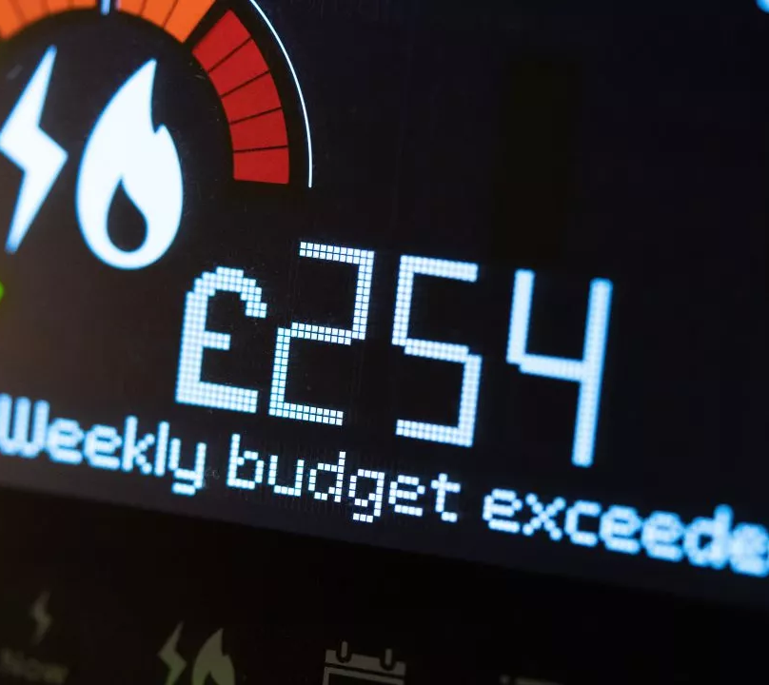
Customers are preoccupied with the cost of living crisis – with wide-ranging implications.
They rate water bill VFM and affordability lower than in 2018, and are reluctant to think about further bill increases.

Slide 13
Importance of investment areas

Slide 14
We described 3 potential investment areas
14
Safe & high-quality drinking water
Ensuring a reliable water supply
Wastewater, protecting and improving the environment
Water has to be treated to remove any pollution or contaminants from the hills or rivers where water is collected.
Welsh Water will make sure its tap water is always safe to drink.
But sometimes tap water quality may be affected by:
Water companies have to plan ahead to ensure enough water in the long-term, as well as preventing temporary interruptions to supply in the short-term.
They can address this by:
Water companies treat used water (or ‘wastewater’) so that it doesn’t harm the environment. When things go wrong it can cause pollution.
If sewers fill up with rainwater, they can spill wastewater into rivers before it is treated. This problem is worsening with climate change.
Investment could include:
Spending more to find and repair leaks
Reducing the risks of burst pipes and protecting treatment plants from failing
Encouraging customers to use less water
Investing in new sources of water (e.g. reservoirs) if necessary
Discolouration, or having a strange taste or smell (it’s still safe to drink)
Traces of lead dissolved from lead pipes in some people’s properties. (These lead pipes are the responsibility of the property owner)
Improving reliability of pipes and treatment works
Reducing rainwater run off into sewers
Increasing sewer capacity

Slide 15
In spite of cost of living pressures, the balance of opinion leans towards Welsh Water prioritising investment in their long term plans, rather than lowest possible bills
15
However, many feel that the two are of equal importance, underlining substantial cost sensitivity and the need for a balanced long term strategy that is highly considerate of bill impact.
% of total sample who think investment area / keeping bills low should be a higher priority
Higher priority
Equal priority
Higher priority
Safe & high-quality drinking water
Keeping bills as low as possible
41%
22%
Ensuring a reliable water supply
Keeping bills as low as possible
40%
20%
Wastewater, protecting, & improving the environment
Keeping bills as low as possible
42%
22%
Q15A, B, C. Which of these do you think should be a higher priority for Welsh Water’s long-term plans, or do you think they should be equal priority? Base All respondents (986)

Slide 16
The balance of opinion specifically amongst household customers is very similar to the overall picture
16
While household customers lean towards Welsh Water prioritising investment in their long term plans, rather than lowest possible bills, many display cost sensitivity and the need for a balanced long term strategy considerate of bill impact.
% of HOUSEHOLD customers who think investment area / keeping bills low should be a higher priority
Higher priority
Equal priority
Higher priority
Safe & high-quality drinking water
Keeping bills as low as possible
40%
23%
Ensuring a reliable water supply
Keeping bills as low as possible
39%
20%
Wastewater, protecting, & improving the environment
Keeping bills as low as possible
41%
21%
Q15A, B, C. Which of these do you think should be a higher priority for Welsh Water’s long-term plans, or do you think they should be equal priority? Base All household respondents (936)

Slide 17
Amongst non household customers there’s slightly more emphasis on investment rather than keeping bills as low as possible
17
Even though NHH are not necessarily finding bills more affordable than NHH, there may be slightly greater appreciation of the need to invest in ensuring resilience into the future. Differences are only indicative due to low NHH base size.
% of NON HOUSEHOLD customers* who think investment area / keeping bills low should be a higher priority
Higher priority
Equal priority
Higher priority
Safe & high-quality drinking water
Keeping bills as low as possible
48%
18%
Ensuring a reliable water supply
Keeping bills as low as possible
46%
20%
Wastewater, protecting, & improving the environment
Keeping bills as low as possible
44%
26%
Q15A, B, C. Which of these do you think should be a higher priority for Welsh Water’s long-term plans, or do you think they should be equal priority? Base All non household respondents (50*) *LOW BASE SIZE, INDICATIVE ONLY

Slide 18
Over one third of customers prioritise lowest possible bills over at least one investment area
18
However, the sentiment to prioritise lowest possible bills over investment is not driven by those who are in difficult financial circumstances.
% who prioritise low bills over at least one investment areas
Those who prioritise keeping bills as low as possible are NOT more likely to be struggling to afford their bill or have a lower income.
Struggling to afford does not translate into prioritising lowest possible bills. Most who are in difficult financial circumstances still recognise the importance of ensuring clean and reliable water and environmental custodianship.
HOUSEHOLD CUSTOMERS
% who prioritise keeping bills low over at least one investment area
NON HOUSEHOLD CUSTOMERS*
% who prioritise keeping bills low over at least one investment area
Q15A, B, C. Which of these do you think should be a higher priority for Welsh Water’s long-term plans, or do you think they should be equal priority? Base All household respondents (936); All non household respondents (50*) *LOW BASE SIZE, INDICATIVE ONLY

Slide 19
In spite of the cost of living context, customers acknowledge that long term investment is important – but it needs to be carefully balanced against bill increases.

Slide 20
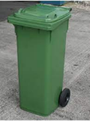
Long term objectives shown
20
Safe & high-quality drinking water
Ensuring a reliable water supply
Wastewater, protecting and improving the environment
Reducing incidents of tap water being temporarily discoloured or having an unusual taste or smell (it’s still safe to drink)
Reducing incidents where customers are without water for 3+ hours because of problems on the network such as burst mains
Reducing sewer overflows and flooding in streets and gardens
Replacing lead pipes in customers’ properties to reduce the risk of lead traces in the water.
Reducing leakage by replacing water mains pipes, and faster detection & repair of new leaks
Minimising sewer flooding inside customers’ properties
Working with landowners to prevent contamination of the water that runs off the hills into reservoirs. The cleaner the water entering reservoirs, the less money needs to be spent on water treatment.
Reducing customers’ water use, by encouraging and helping them to save water (e.g. through campaigns and providing water-saving devices)
Improving the quality and cleanliness of rivers by improving wastewater treatment works and sewerage systems

Slide 21
Importance of objectives
21
Combining views of both households and non-households, investment into leaks from pipes is seen significantly more important than other objectives. Sewer flooding and river water quality are ‘second tier’ with lead pipes (customer responsibility) and helping customers save water ranked as least important overall.
Ranking of objectives that think are most important to address in long term plans (% of total sample)
Rank in top 3 | 51% | 39% | 39% | 38% | 29% | 26% | 24% | 20% | 17%
Q19 Here’s a list of all the objectives we’ve shown you, across all 3 areas of investment. Please can you rank the 5 that you think are most important for Welsh Water to address in their long-term plans? ‘1’ is most important, ‘2 second most important’ etc. ? Base Total sample - all household and non household respondents (986). RANKED ON % RANKING 1 or 2 or 3

Slide 22
Who ranks objectives higher?
22
Highest rank (Top 3)
Leaks from pipes | Older customers (60+ years old) | Older customers can often have greater sense of ‘waste not want not’
Sewer flooding inside properties | No significant differences
Sewer flooding of streets and gardens | No significant differences
River water quality | Highest income customers (£50k+) | More affluent customers may have greater concern / awareness of local environmental harm
Contamination of water from land | Non households* | Some NHH customers may be more aware of catchment management and can play a role here
Tap water quality | 18-29s year olds Community Hub participants Vulnerable – connectivity* | Suggestion that some groups are more sensitized to / have more experience of tap water issues
Being without water | 18-44 year olds Larger households. | Extended periods of being without water may be more problematic for young families
Lead pipes | No significant differences
Helping customers save water | No significant differences
Q19 Here’s a list of all the objectives we’ve shown you, across all 3 areas of investment. Please can you rank the 5 that you think are most important for Welsh Water to address in their long-term plans? RANKED ON % RANKING 1 or 2 or 3
* CAUTION, based on small base size

Slide 23
The more considered Qualitative response reveals differing views on tap water quality & lead
23
Qualitative perspective
Higher rank in quantitative (Top 3)
Leaks from pipes | Current leakage shocking – customers want leaks to be eliminated completely Low understanding of sustainable leakage; low awareness of costs & disruption to eliminate
Sewer flooding inside properties | It sounds horrendous and should never happen to anyone; want issue eliminated - unacceptable Some awareness that customers themselves also have a role here
Sewer flooding of streets and gardens | Feels important due to environmental impact On discussion, view that other organisations (planners, local govt) also have a role in this
River water quality | n/a - covered in the Quantitative stage only
Contamination of water from land | Concept of water catchments not always well understood, but their water quality feels important Not seen as an objective with real touchpoints for customers (more internal company workings)
Tap water quality | Rarely a problem experienced by the qual sample and mostly cosmetic – so lower importance Surprised that DCWW performs poorly in this area, but this doesn’t alter their views
Being without water | Support objective but feels like ‘BAU’. Some confusion: Avg. 16 min outage doesn’t seem bad. Outages of 2+ hours would be a problem - but had not been experienced
Lead pipes | Qualitatively, a much more emotive and urgent perspective, when customers informed of adverse effect on health & development for babies &children – this promotes altruism But some polarisation, with some thinking homeowners, not DCWW, should pay for replacement
Helping customers save water | Speaks to customer’s instincts to ‘do their bit’ but reducing use shouldn’t focus only on customers Some question spending on ad campaigns
n/a
Qualitative and quantitative align
Lower importance in qualitative
Higher importance in qualitative

Slide 24
Leaks, sewer flooding and lead pipes provoke a stronger response – can feel unacceptable
24
Higher rank in quantitative (Top 3)
Leaks from pipes
Sewer flooding inside properties
Sewer flooding of streets and gardens
River water quality
Contamination of water from land
Tap water quality
Being without water
Lead pipes
Helping customers save water
“Very important, water is so precious. I’m surprised by the figure being at 20%, even 10% seems like a lot to lose.”(HH customer, ABC1 older)
“I would of thought that sewer flooding inside a home would need taking to zero because that’s one of the worst things that could happen to you.” (NHH customer, critical water use)
“A problem which will only get worse. I can't imagine anything worse. They have to act on it.”
(HH customer, C2D older)
n/a
“It is very important because you’re talking about the possibility of the water supply being contaminated.”(NHH customer, domestic water use)
“It's an inconvenience but they do fix it quickly, I don’t know if this where the main investment should be.”(Future customer, student)
“It is a really important objective but, when you understand how many minutes it is, when you compare it to the other issues, I don’t really think it’s a major problem.” (HH, C2D younger)
“I’d probably put that as more important because obviously lead traces in drinking water do come with health issues” (HH customer, C2D older)
“I think education is always good. We all have to live with ourselves and do what we can and if we’re educated we can do what we can.”(HH customer, C2D older)
Source: Qualitative phase

Slide 25
Focus on lead pipes – exploring tensions in the importance / urgency reported
25
Views on lead pipes can be polarised and information shared with customers is pivotal
The current status quo is that people don’t think lead pipes are widespread and so it is not a significant issue.
However, when it is revealed in qualitative conversation that many lead pipes are still present, and potential impact on the health of children and babies, lead becomes a highly pressing investment area
Meanwhile in research where health issues are not highlighted, and it is clarified that lead pipes are the responsibility of the property owner, the prioritisation for DCWW to invest is much lower
This is a potentially highly emotive area and needs careful handling – could it be the next ‘CSOs’?
The situation of lead pipes is not new, but we are in an era of increased social media activism and greater public scrutiny…
“Don’t leave it and leave it and leave it… it could be a ticking timebomb”.
“I would say you want to start as quickly as possible don’t you, surely that’s a health risk and you’ve got to make a risk assessment I suppose on people’s health and wellbeing.” Economically vulnerable
“Don’t leave it and leave it and leave it. Because depending on how much water people actually drink it could be a ticking timebomb”. C2D, Older (51+)
“If you consider 2.4 per 1,000 split into 3.1 million (homes), that’s a considerable amount of concern regarding people’s health in the long-term (due to the impacts of lead on the body)”. C2DE, younger (30-50)

Slide 26
Where investment objectives evoke stronger emotions, they’re regarded as more important

Slide 27
Urgency and ambition

Slide 28
Urgency of investing in objectives broadly follows the hierarchy of importance
28
Leaks and sewer flooding felt to be the most urgent. River water quality, despite being important, is a little less urgent and could be more of an ongoing investment area. Investing in lead pipes is the most polarised area – as we see perspectives can vary regarding altruism versus thinking it should be paid for directly by homeowners responsible for the pipes.
MORE URGENT
Q17 If you were Welsh Water, when (if at all) would you invest money on this objective? Remember they cannot do everything at once? Base Total sample - all household and non household respondents (986)
Notes:
Community hub is generally saying investment is higher priority, not low bills…
Struggling to afford does NOT translate into saying lowest possible bills should be the priority

Slide 29
Ambitions shown in the quantitative research
29
Safe & high-quality drinking water
Ensuring a reliable water supply
Wastewater, protecting and improving the environment
To reduce incidents of temporary discolouration or unusual taste / smell by more than half.
(Cutting the number of incidents reported per year from 7,000 to 3,000.)
To reduce interruptions to the water supply lasting 3+ hours by 90%
Welsh Water would be equal to, or better than, other water companies in making sure their customers are not without tap water for 3+ hours.
To reduce the number of times sewers overflow outside by 25%
(From 3700 incidents a year to 2800 a year).
To help society by replacing 100,000 water supply pipes made of lead that are on customers’ properties. (This will be replacing about half of the estimated 200,000 pipes made of lead. Note these are the responsibility of customers)
To halve the amount of water that leaks from Welsh Water’s network.
Around 20% of water is lost through leaks in the network or on customer properties. Welsh Water want to reduce this to 10%.
To reduce the number of times sewers flood inside customers properties by 40%
(From 200 a year to 120 a year).
To take action in all catchment areas in Wales to prevent any significant contamination of water from the land. (It is expected that this risk will increase over time due to changes in land use and climate change)
To reduce the amount of water customers use by one third (33%)
On average customers use 167 litres per person per day – about a wheelie bin full of water. This would come down to 110 litres.
To reduce to zero the instances where Welsh Water’s handling of sewage is the cause of poor river water quality

Slide 30
Perceived level of ambition: Should be higher for leaks and sewer flooding
30
The large majority think that DCWW ought to be more ambitious in their long-term outcomes for water leaks and sewers flooding. Around half also think ambitions for tackling poor river quality and contamination from the land should be more stretching – suggesting they want DCWW to be broader custodians of river environments.
Should be more ambitious: | 65% | 66% | 56% | 50% | 50% | 45% | 36% | 37% | 37%
Q18 What best describes your view of this long-term ambition?
Base Total sample - all household and non household respondents (986)

Slide 31
Urgency x Ambition – ALL HH and NHH customers
31
Greater perceived urgency tends to broadly correlate with wanting to see more stretching long term ambitions. Relative urgency is a little lower for outdoor sewer flooding, river quality & lead pipes (in the quantitative – see discussion on lead).
O
P
Should be slightly more ambitious
I
R
C
Ambition
T
W
S
L
About the right level of ambition
Less urgency
Invest a little on an ongoing basis
More urgency
X-AXIS: Q17. If you were Welsh Water, when (if at all) would you invest money on this objective? Remember they cannot do everything at once?) Y-AXIS: Q18: What best describes your view of this long-term ambition? Remember being more ambitious will cost bill payers more, and being less ambitious will cost bill payers less. Base Total sample - all HH and non HH customers (986)

Slide 32
Urgency x Ambition – All household customers
32
Near identical to the overall sample - greater perceived urgency tends to correlate with wanting to see more stretching long term ambitions. Relative urgency is a little lower for outdoor sewer flooding, river quality & lead pipes.
O
P
Should be slightly more ambitious
I
R
C
T
Ambition
W
S
L
About the right level of ambition
Less urgency
Invest a little on an ongoing basis
More urgency
X-AXIS: Q17. If you were Welsh Water, when (if at all) would you invest money on this objective? Remember they cannot do everything at once?) Y-AXIS: Q18: What best describes your view of this long-term ambition? Remember being more ambitious will cost bill payers more, and being less ambitious will cost bill payers less. Base All HH customers (936)

Slide 33
Urgency x Ambition – Non household customers
33
While there are few significant differences, NHH indicatively look for more ambition on leaks, and more urgency on river water quality & not being without water – areas where some may have more dependency / obligation than HH.
P
O
Should be slightly more ambitious
R
I
C
Ambition
T
W
S
About the right level of ambition
L
Less urgency
Invest a little on an ongoing basis
More urgency
X-AXIS: Q17. If you were Welsh Water, when (if at all) would you invest money on this objective? Remember they cannot do everything at once? Base NHH customers (50). Y-AXIS: Q18: What best describes your view of this long-term ambition? Remember being more ambitious will cost bill payers more, and being less ambitious will cost bill payers less. Base NHH customers (50*) *CAUTION LOW BASE INDICATIVE ONLY

Slide 34
Urgency x Ambition – Community Hub participants
34
Community Hub participants indicate more urgency and want more ambition for several outcomes: lead pipes, saving water, being without water, tap water & river quality; however they are slightly less demanding on ambition for leaks.
I
O
Should be slightly more ambitious
R
P
C
T
W
S
Ambition
L
About the right level of ambition
Less urgency
Invest a little on an ongoing basis
More urgency
X-AXIS: Q17. If you were Welsh Water, when (if at all) would you invest money on this objective? Remember they cannot do everything at once? Y-AXIS: Q18: What best describes your view of this long-term ambition? Remember being more ambitious will cost bill payers more, and being less ambitious will cost bill payers less. Base Community Hub respondents (seldom heard sample)(134).

Slide 35
Urgency x Ambition – Any vulnerability
35
Overall there few differences for customers with an indicator of vulnerability, although lead pipes, appears to be both an objective of more urgency and requiring more ambition compared to all households – relating to health concerns?
O
Should be slightly more ambitious
P
I
R
C
T
Ambition
W
L
S
About the right level of ambition
Less urgency
Invest a little on an ongoing basis
More urgency
X-AXIS: Q17. If you were Welsh Water, when (if at all) would you invest money on this objective? Remember they cannot do everything at once? Y-AXIS: Q18: What best describes your view of this long-term ambition? Remember being more ambitious will cost bill payers more, and being less ambitious will cost bill payers less. Base Those with any vulnerability(497)

Slide 36
Urgency x Ambition – A stretch to afford or cannot afford bill
36
No significant differences between those struggling to afford compared to all household customers – bill affordability does not seem a critical factor in determining outlook on urgency and ambition of the 9 outcomes.
O
P
Should be slightly more ambitious
I
R
C
Ambition
T
W
L
S
About the right level of ambition
Less urgency
Invest a little on an ongoing basis
More urgency
X-AXIS: Q17. If you were Welsh Water, when (if at all) would you invest money on this objective? Remember they cannot do everything at once? Y-AXIS: Q18: What best describes your view of this long-term ambition? Remember being more ambitious will cost bill payers more, and being less ambitious will cost bill payers less. Base A stretch to afford or cannot afford bill (362)

Slide 37
Urgency x Ambition – Younger customers (18-29)
37
The youngest age group are less discriminating on different objectives. For them leaks is much less pressing than for other groups, while addressing sewer flooding inside properties most urgent. Lead is also more urgent than on average.
Should be slightly more ambitious
C
O
P
I
R
T
Ambition
W
L
S
About the right level of ambition
Less urgency
Invest a little on an ongoing basis
More urgency
X-AXIS: Q17. If you were Welsh Water, when (if at all) would you invest money on this objective? Remember they cannot do everything at once? Y-AXIS: Q18: What best describes your view of this long-term ambition? Remember being more ambitious will cost bill payers more, and being less ambitious will cost bill payers less. Base HH customers aged 18-29 (94*) CAUTION LOW BASE.

Slide 38
Urgency x Ambition – Older customers (60+)
38
The oldest age group express high demand for more ambition and more urgency on sewer flooding and leaks from pipes.
O
P
I
Should be slightly more ambitious
R
C
T
Ambition
W
S
About the right level of ambition
L
Less urgency
Invest a little on an ongoing basis
More urgency
X-AXIS: Q17. If you were Welsh Water, when (if at all) would you invest money on this objective? Remember they cannot do everything at once? Y-AXIS: Q18: What best describes your view of this long-term ambition? Remember being more ambitious will cost bill payers more, and being less ambitious will cost bill payers less. Base HH customers aged 60+ (350)

Slide 39
Summary: Differences to the overall view amongst different customer groups
39
Differences are generally not dramatic, but signs that certain groups have a stronger view about certain outcomes. Older customers notably pushing for more ambition in leakage & sewer flooding; Community Hub, younger and vulnerable find lead pipes more pressing. NHH greater emphasis on environment, leakage & resilience.
 | NHH | Community Hub | Age 18-29 | Age 60+ | Any indicator of vulnerability | Struggling / can’t afford bill
Reducing leakage | More ambition | Less ambitious | Less urgent and less ambition | More urgent and more ambition | No difference | No difference
Minimising sewer flooding inside customers’ properties | Less urgent and less ambition | No difference | More urgent, less ambition | More urgent and more ambition | No difference | No difference
Reducing sewer overflows and flooding in streets and gardens | No difference | No difference | Less urgent and less ambition | More urgent and more ambition | No difference | No difference
Improving quality and cleanliness of rivers | More urgent and more ambition | More ambition | Less urgent and less ambition | No difference | No difference | No difference
Working with landowners to prevent contamination of water run off | More urgent but less ambition | No difference | No difference | No difference | No difference | No difference
Reduce incidents of tap water being discoloured / unusual taste, smell | Less urgent and less ambition | More urgent and more ambition | No difference | No difference | No difference | No difference
Reducing incidents of being without water for 3 hrs + | More urgent | More urgent and more ambition | No difference | No difference | No difference | No difference
Replacing lead pipes in customers’ properties | Less urgent | More urgent and more ambition | More urgent and more ambition | No difference | More urgent and more ambition | No difference
Reducing customers’ water use | Less urgent | More urgent and more ambition | No difference | No difference | No difference | No difference

Slide 40
Customers indicate that they want to see more long-term ambition particularly in the areas of leakage and sewer flooding – with a more polarised view on lead pipes.

Slide 41
Intergenerational Fairness

Slide 42
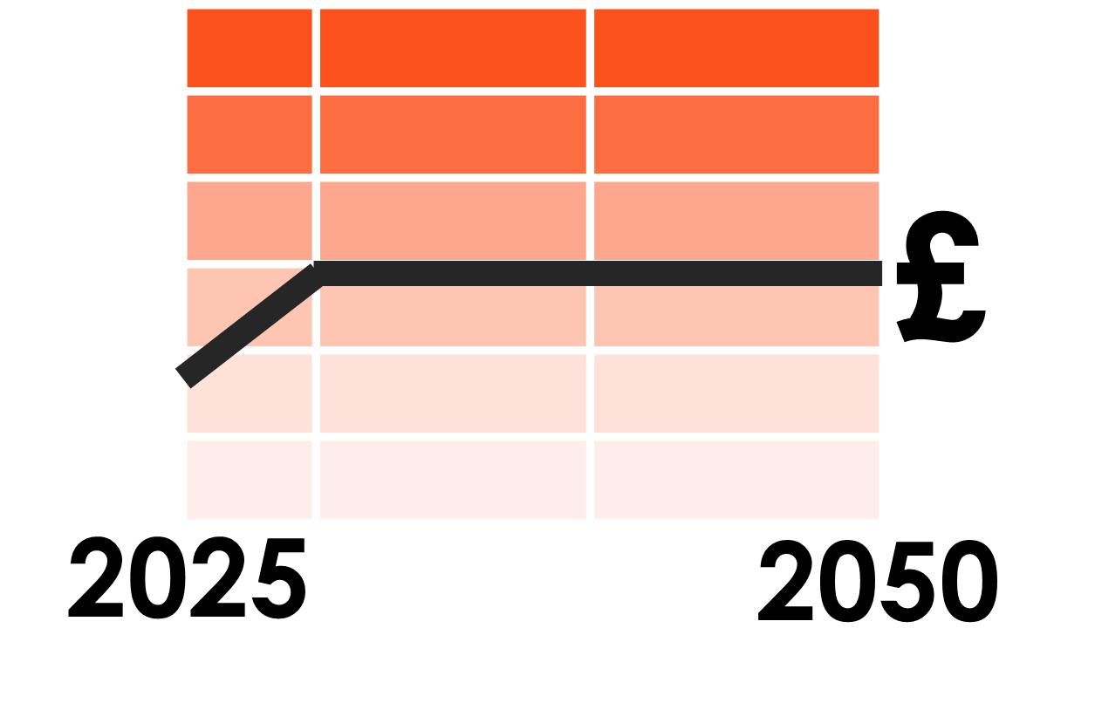
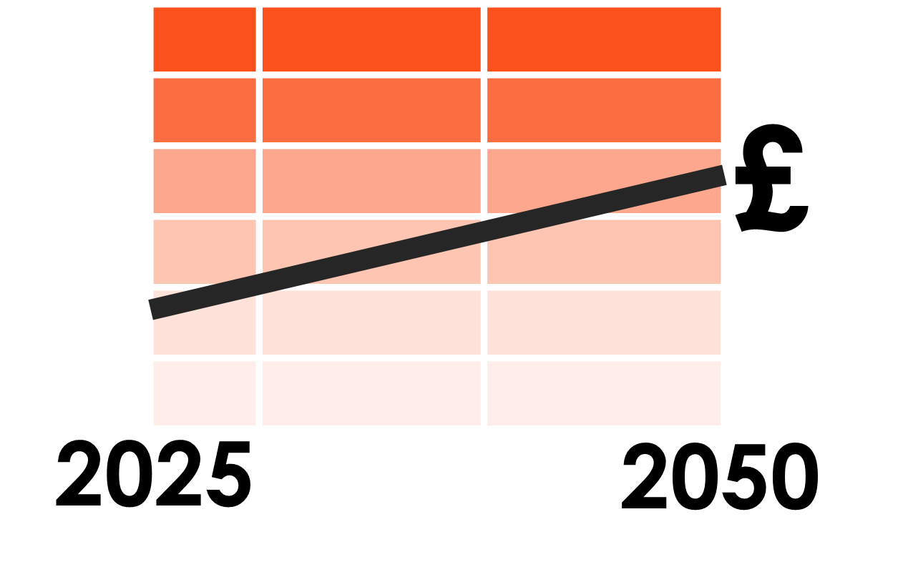
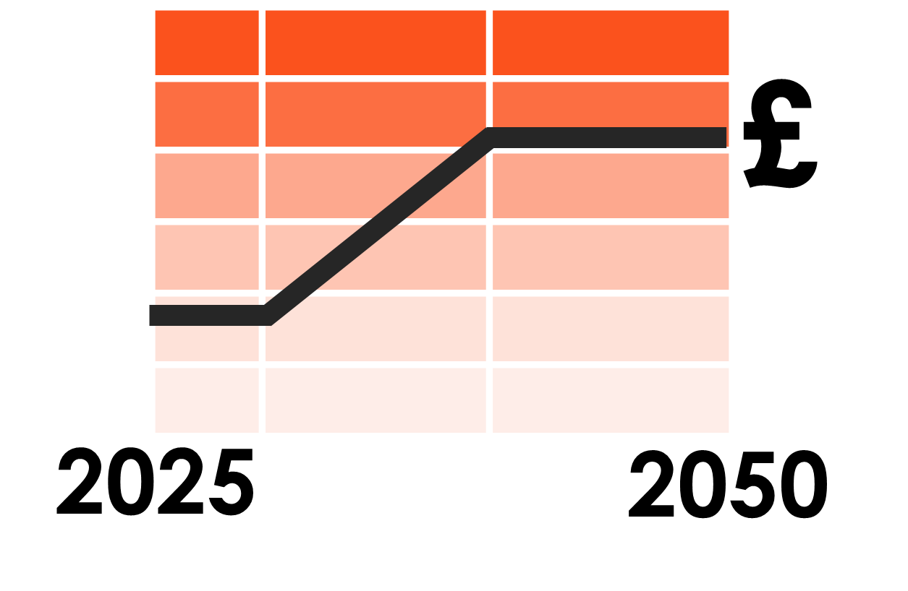
Intergenerational Fairness – Total Sample
42
Overall, the ‘fairest’ and most preferred long term bill profile scenario is gradual investment over the longer run. Delaying investment until the medium term is deemed least fair, and is by far the least preferred of the three options.
Qualitative insight: Ability to have a ‘selfish’ and a societal view.
Scenario 2 is seen as the fairest overall, as bill increases and impact will be spread out.
But need reassurance that the right investments are being prioritised to minimise problems down the track (e.g. leak reduction and protecting treatment works etc.).
Preference when looking at 3 scenarios again
Investment sooner rather than later
36%
Gradual investment over next 25 years
47%
Investment delayed until the medium term
6%
Q20A, B, C. Thinking about the bill and the impacts for customers now and in future, overall how fair or unfair do you think this scenario is? Base Total sample – Household and non household (986)

Slide 43
Generations tend to reach the same conclusion when discussed together (in paired depths)
43
Ultimately, preference for gradual investment (scenario 2) as it feels ‘fairest’ for society in the context of the cost of living crisis and need to protect the environment from growing challenges.
“With the cost of living crisis, dealing with 10-20% is a lot with all the other bills. It’s scary having to put your wellbeing over the wellbeing of the planet itself. As someone living on the minimum wage it goes against your morals.” Younger/future
“It is fair in terms of every generation paying the same amount. Not loading people now or in the future.” Younger/future
“The only pro is it is cheaper now. But this is detrimental for society.” Younger/future
“This creates a perfect storm for younger generations – but good for the environment.” Older
“It lessens the impact of the bill but we’ll take longer to get there.” Older
“My generation caused a lot of this – we should pay the bills. There are always reasons to not spend on climate change because it changes slowly. But that is why we are in this mess now.” Older

Slide 44
Investment Scenario Preference / Intergenerational Fairness
44
18-29 prefer investment sooner rather than later, while 60+ prefer gradual investment over 25 years (along with majority).
Survey shows younger more likely to see investment as more urgent. But qualitatively we also heard the internal conflict between managing personal costs and the ‘moral’ obligation to protect the environment. NB intergenerational qualitative sample was small.
Q21. Looking again at the three scenarios, which one would you prefer? Base HH customers (936); 18-29 (94); 30-44 (256); 45-59 (234); 60+ (350); Any vulnerability (497)

Slide 45
Despite the immediate concerns of cost of living, few advocate delaying investment until the medium run; a gradual investment approach is considered the fairest and is most preferred.

Slide 46
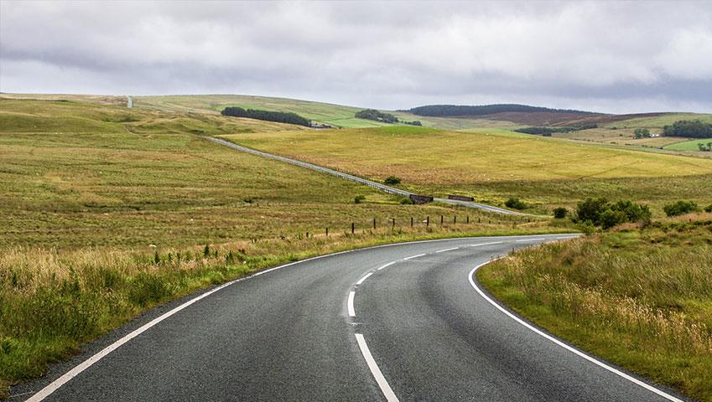
Summary

Slide 47
Overarching themes
47
1
At the moment people are highly preoccupied with cost of living, and at saturation point with bill and price increases
Despite this, the majority acknowledge the need for longer-term investment and are open to some degree of bill increase to support this, rather than wanting to completely prioritise bills being as low as possible
2
Customers are generally not aware of threats to water supply, and so not spontaneously concerned about the prospect of deteriorating service from Welsh Water
Initially they don’t feel drastic investment is needed, but after being prompted to think about the longer-term future, they acknowledge reliable service is not a ‘given’ and some level of future investment is needed to address future challenges
3
There is growing concern over declining river quality
Significant concern about combined sewer overflows and declining river health, and impact on the environment.
Welsh Water are less trusted in managing this than they are for providing a reliable water supply
Investing in wastewater and the environment is deemed just as important as investing in high quality and reliable supply
4
Broadly, ‘importance’ and ‘urgency’ of long-term objectives are closely related
Consistently leakage and internal / external sewer flooding are seen as most important and urgent
Lead pipes is more polarising and an outcome area for careful consideration
And river quality is important but not quite so urgent as some other objectives
A sense that some objectives are ‘new investment needed’ vs. others which are ongoing priorities (day-to-day ‘BAU’)
Question whether others (e.g. local government) are also responsible – should everything fall to DCWW customers?
5
Customers push back on a number of specific levels of ambition within DCWW’s plans, where the targets don’t feel ambitious enough
Particularly leakage, internal and external sewer flooding.
6
Overall, the ‘fairest’ and most preferred long-term bill profile scenario is seen as gradual investment over the longer run
On discussion, different generations tend to reach the same conclusion
Few prefer the scenario where investments are delayed – deemed much less fair

Slide 48
Summary: Higher priority long-term outcomes
48
Both the less informed (Quant) and more informed (Qual) view is that tackling leakage and sewer flooding (indoor & outdoor) should be key areas for investment– and that the long term targets described are not ambitious enough. There is felt to be particular urgency for investing into fixing leaks – people are often shocked to see information on current leakage.
Leakage
Sewer flooding
‘Reducing river pollution and improving water quality’ was Priority #2 in the previous research conducted by Relish, and also one of the more important objectives in this latest work. The long term ambition ‘to reduce to zero the instances where Welsh Water’s handling of sewage is the cause of poor river water quality’ may not be enough; Phase 1 suggests people want river water quality to be actively improved and river pollution reduced. Visible participation in active clean up efforts would be well received. However, while important, this objective is not quite as urgent as some others - customers lean towards ‘a little investment on an ongoing basis’ to achieve it.
Improving quality and cleanliness of rivers
Views on lead pipes can be polarised and information shared with customers is pivotal. The current status quo is that customers don’t think lead pipes are widespread and so not a significant issue. However, when it is revealed that many lead pipes are still present, and potential impact on the health of children and babies is discussed, lead becomes a highly pressing investment area. Meanwhile in research where health issues are not highlighted, and it is clarified that lead pipes are the responsibility of the property owner, the prioritisation for DCWW to invest is much lower. This is a potentially highly emotive area and needs careful handling – could it be the ‘next’ CSOs?
?
Replacing lead pipes
Reducing risk of major disruption
Qualitatively, strong support for this objective however it is not always clear why this merits additional investment rather than being BAU.
Protecting critical assets
Qualitatively, support for this objective to protect environment from pollution – but risk and response beyond customers’ experience / less accessible.

Slide 49
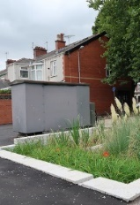
Summary: Lower priority long-term outcomes
49
Can be a difficult idea to convey to customers. Nevertheless there is a sense that it is an important aim and that collaboration is a key element in achieving it. The outcome targets shown can feel ambiguous and ‘non tangible’ and many think the target should be clearer / more ambitious. Non household customers (some of whom could be possible participants in catchment collaboration) rank this as slightly more important than household customers.
Low on the agenda in the qualitative research due to good personal experience, but both stage 1 quant and stage 2 quant put this as a moderately high priority; Over 4 in 10 customers think the long-term target of reducing incidents by c. half should be more ambitious.
Support for this objective as a practical solution with local amenity value – but it is relegated as less important than other issues (and questions about responsibility for this; water company vs. local authority/city councils).
Reducing supply interruptions of 3+ hours is, based on personal experience of reliable supply, not regarded as being as important an investment area as many others. For the majority, the long-term target of reducing interruptions by 90% is regarded as being ‘the right level of ambition’.
Customers are broadly supportive of the sentiment of encouraging reduced water use, but this is the least highly ranked of the long term objectives in terms of importance; people do not always appreciate need / urgency for this action in Wales. There’s also a sense that reducing water use shouldn’t focus only on customers, and some question spending on ad campaigns to achieve this.
Contamination of water from land
Tap water quality
Sustainable urban drainage
Being without water (for 3+ hours)
Helping customers use less water

Slide 51
Quantitative phase sample profile
51
 | Group | Unweighted number | Weighted number (% of total) * % of HH
Sample groups | Total | 986 | 986 (100%)
 | HH Customers Total | 936 | 906 (92%)
 | Online HH Total | 802 | 804 (82%)
 | Community Hub Total | 134 | 102 (10%)
 | Online NHH | 50 | 80 (8%)
Age (household customers only) | 18-29 | 94 | 50 (6%*)
 | 30-44 | 256 | 247 (27%*)
 | 45-59 | 234 | 272 (30%*)
 | 60+ | 350 | 336 (37%*)
Gender (household customers only) | Male | 375 | 453 (50%*)
 | Female | 561 | 454 (50%*)
Socio economic grade (household customers only) | AB | 232 | 163 (18%*)
 | C1C2 | 364 | 462 (51%*)
 | DE | 323 | 263 (29%*)
 | Not disclosed | 15 | 16 (2%*)
Any indicator of vulnerability | Yes | 497 | 392 (43%*)
 | No | 439 | 514 (57%*)
The overall dataset was weighted by key demographics, region and actual proportion of household and non household customers to provide a representative overall view.

